Slide 1
Story of Stuff
{Earth Systems & Resources: Studying the state of our Earth

Slide 2
Take notes on these topics
Extraction
Production
Distribution
Consumption
Disposal

Slide 3
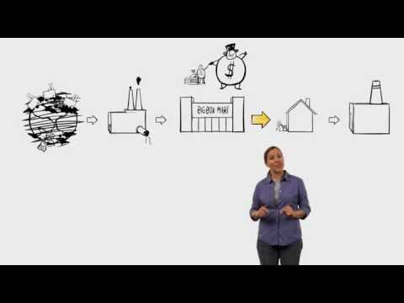
The Story of Stuff

Slide 4
What is this?
Extraction
Production
Distribution
Consumption
Disposal

Slide 5
Questions
What do you do as an individual to help reduce “stuff”?
What can we (as a society) do to make a change?

Slide 6
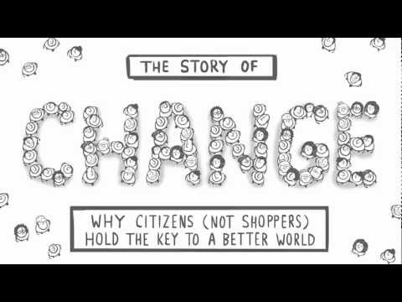
The Story of Stuff

Slide 7
Take notes on these topics
What is the “Game of More”?
What Solutions do you have?
What is GDP?
What “Better” goals can we make?
How does Annie Leonard identify a campaign, or real solution?

Slide 8
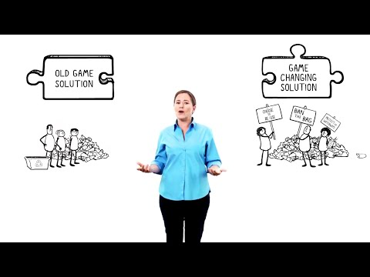
The Story of Stuff

Slide 9
Questions
What is the “Game of More”?
What Solutions do you have?
What is GDP?
What “Better” goals can we make?
How does Annie Leonard identify a campaign, or real solution?
What are some of the “Game Changing” solutions that you have? or ones that have already been implemented?

Slide 10
Additional Features (Optional)

Slide 11
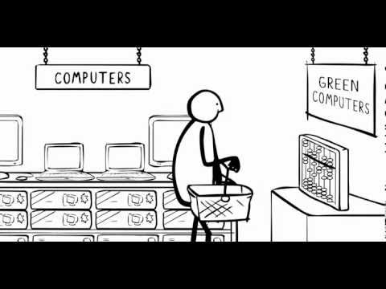
The Story of Stuff

Slide 12
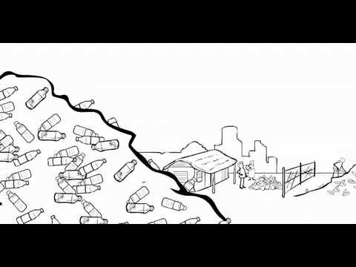
The Story of Stuff

