Slide 1
Solar Eclipse 2017

Slide 2
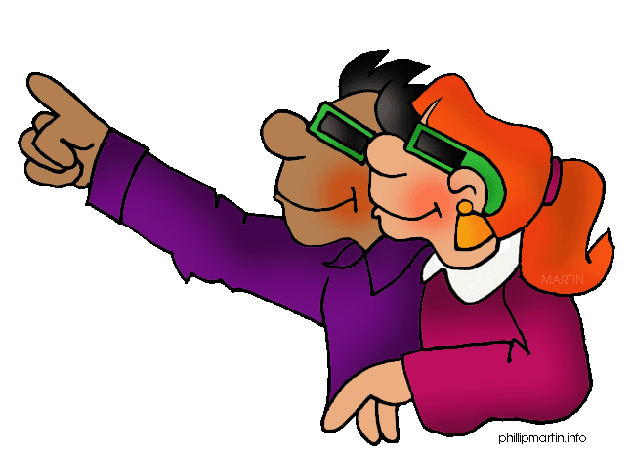
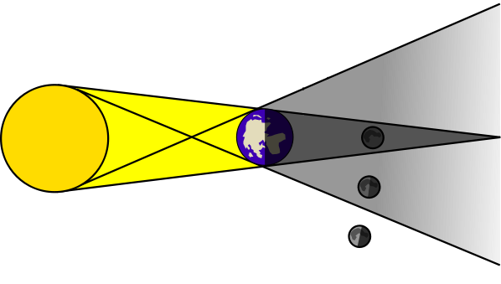
Solar vs Lunar Eclipses
What is a lunar eclipse? What is a solar eclipse?
(Discuss the differences as a table and write down a definition for each in your notebook).
Video
After watching the video, draw a model of both a solar and lunar eclipse. Make sure to label the Earth, Moon and Sun.

Slide 3
Plot the Path of Today’s Eclipse

Slide 4
Science Explained through Mythology
Ancient people were convinced a solar eclipse was a sign of something horrible. Some civilizations believed that the Sun was being eaten by some sort of animal, such as a dragon or wolf. They felt the only way to free the Sun was to act wild. So, the people would make noises called hullabaloos while dancing around and acting crazy. They continued this until the Sun was "free" from the animal.
Others believed an eclipse was a sign of disease and death. In South America, they believed a hidden Sun was the source of smallpox and the Spanish influenza. Some thought the Moon was evil, and chased after the Sun. In some stories, the Sun goddess was being chased by her brother, the Moon god. When he caught up with her, he would do evil things. People thought this meant evil things would happen on Earth.

Slide 5
Write a Myth
Write your own short myth that explains a total solar eclipse. Be creative. You may use pictures to support your writing.

