Slide 1
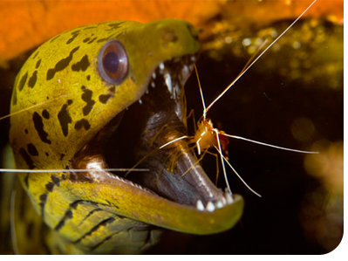
Species Interactions

Slide 2
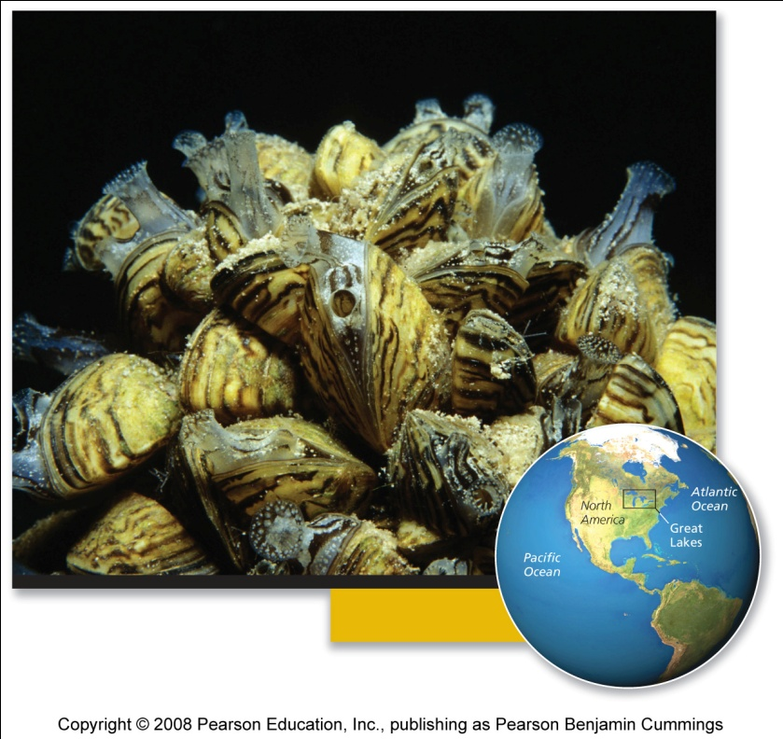
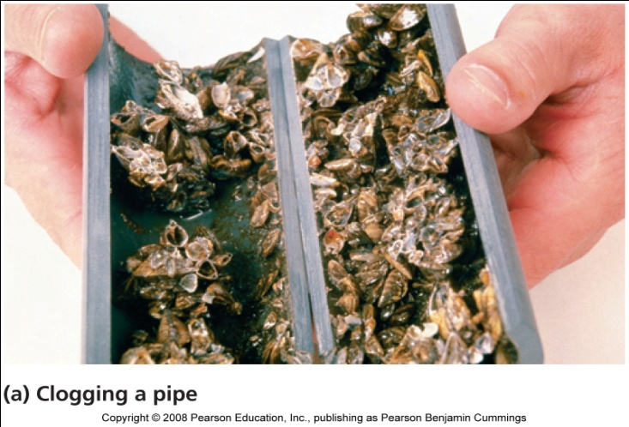
Case Study: Black & white and spread all over
Small, black and white shellfish
Introduced to Lake St. Clair, Canada, in 1988, in discharged ballast water
Within 2 years, the zebra mussels invaded all 5 Great Lakes
Populations grew exponentially
  No natural predators, competitors, or parasites
Hundreds of millions of dollars of damage to property
Deplete phytoplankton populations

Slide 3
Species interactions
Species interactions are the backbone of communities
Symbiosis: a close relationship between two organisms from different species. It is sometimes, but not always, beneficial to both organisms.
Most important categories
  Competition = both species are harmed
  Predation, parasitism, and herbivory = one species benefits and the other is harmed
  Commensalism = one species benefits , one unaffected
  Mutualism = both species benefit

Slide 4
Competition
Competition = relationship where multiple organisms seek the same limited resources they need to survive:
  Food - Water
  Space - Shelter
  Mates - Sunlight
Intraspecific competition = between members of the same species
  High population density = increased competition
Interspecific competition = among members of 2 or more species
  Leads to competitive exclusion or species coexistence

Slide 5
Results of interspecific competition
Competitive exclusion = one species completely excludes another species from using the resource
Species coexistence = neither species fully excludes the other from resources, so both live side by side
  This produces a stable point of equilibrium, with stable population sizes
  Species adjust (change behavior) to minimize competition by using only a part of the available resource

Slide 6
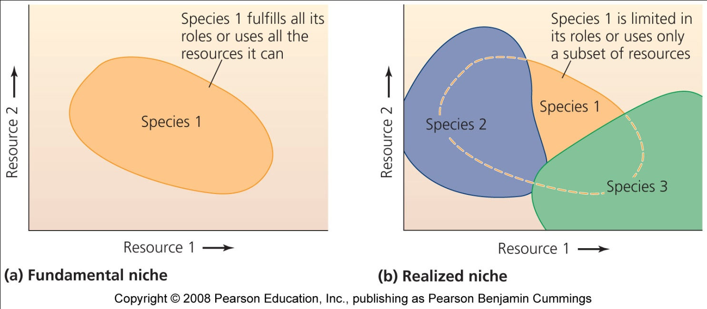
Niche: an individual’s ecological role
Fundamental niche = when an individual fulfills its entire role by using all the available resources
Realized niche = the portion of the fundamental niche that is actually filled or realized
  Due to competition or other species’ interactions

Slide 7
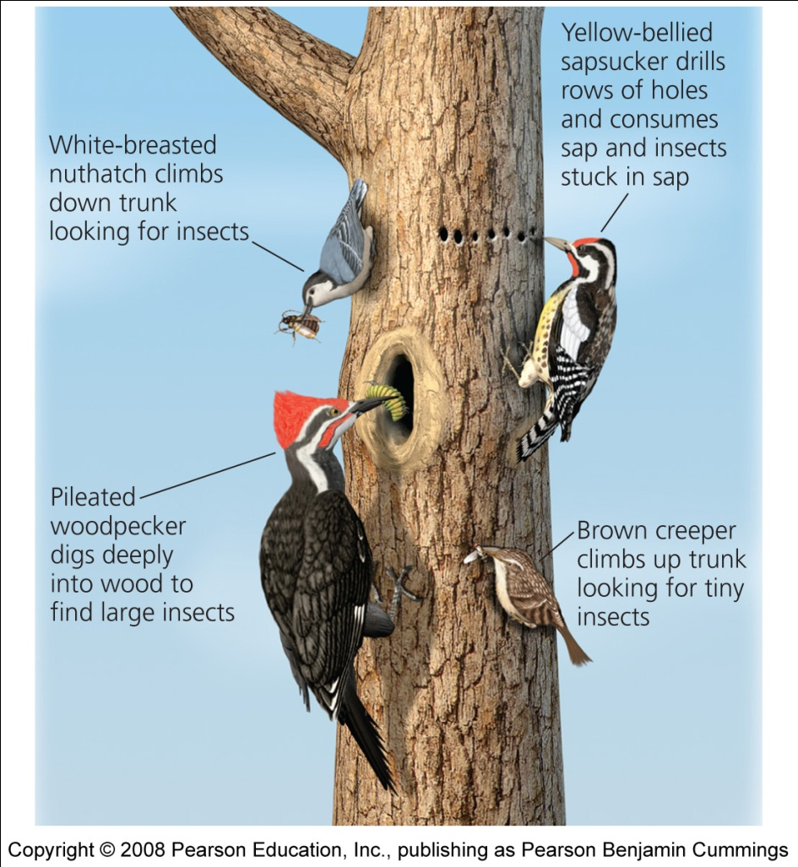
Resource partitioning
Resource partitioning = when species divide shared resources by specializing in different ways
  Ex: one species is active at night, another in the daytime
  Ex: one species eats small seeds, another eats large seeds

Slide 8
Effects of resource partitioning
Character displacement = competing species evolve physical characteristics that reflect their reliance on the portion of the resource they use
  Ex: birds that eat larger seeds evolve larger bills
  Ex: birds that eat smaller seeds evolve smaller bills
Competition is reduced when two species become more different

Slide 9
Exploitive interactions - exploitation
Exploitation = one member exploits another for its own gain, one benefits while one is harmed
  Predation
  Parasitism
  Herbivory

Slide 10
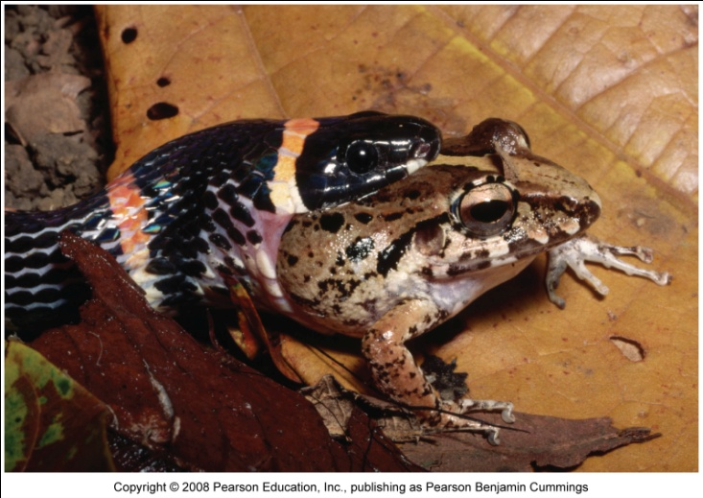
Predation
Predation = process by which individuals of one species (predators) capture, kill, and consume individuals of another species (prey)
  One of the primary organizing forces in a community
  Interactions structure food webs
  Influences community composition by determining relative abundance of predators and prey

Slide 11
Effects of zebra mussels
Zebra mussels eat phytoplankton and zooplankton
  Both populations decrease in lakes with zebra mussels
They don’t eat cyanobacteria
  Population increases in lakes with zebra mussels
Zebra mussels are becoming prey for some North American predators:
  Diving ducks, muskrats, crayfish, flounder, sturgeon, eels, carp, and freshwater drum

Slide 12
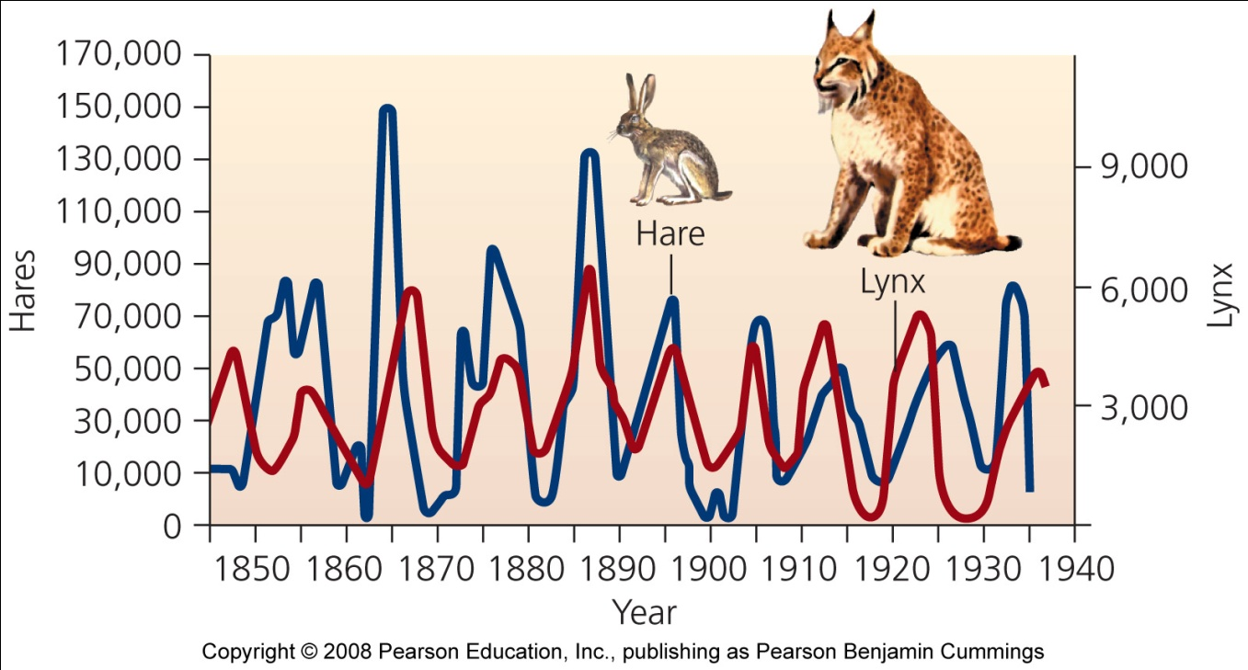
Effects of predation on populations
Predation can drive population dynamics (cyclic)
Increased prey populations increases predators
  Predators survive and reproduce
Increased predator populations decrease prey
Decreased prey population causes starvation of predators
Decreased predator populations increases prey populations

Slide 13
Natural selection-evolutionary impacts of predation
Natural selection leads to evolution of adaptations that make predators better hunters
Individuals who are better at catching prey:
  Live longer, healthier lives
  Take better care of offspring
Predation pressure: prey are at risk of immediate death
  Prey develops elaborate defenses against being eaten

Slide 14
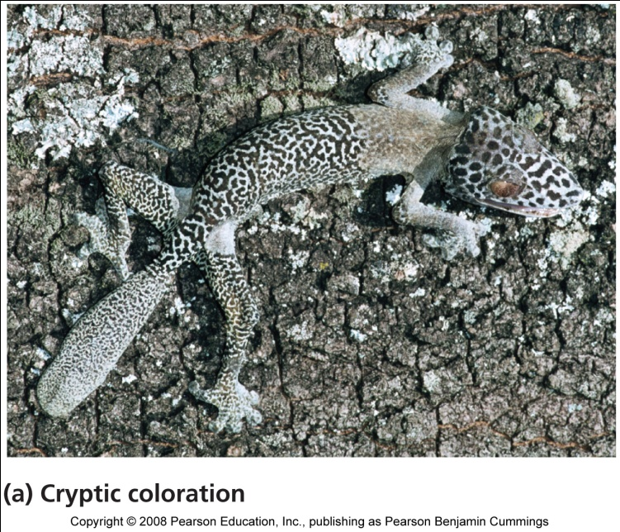
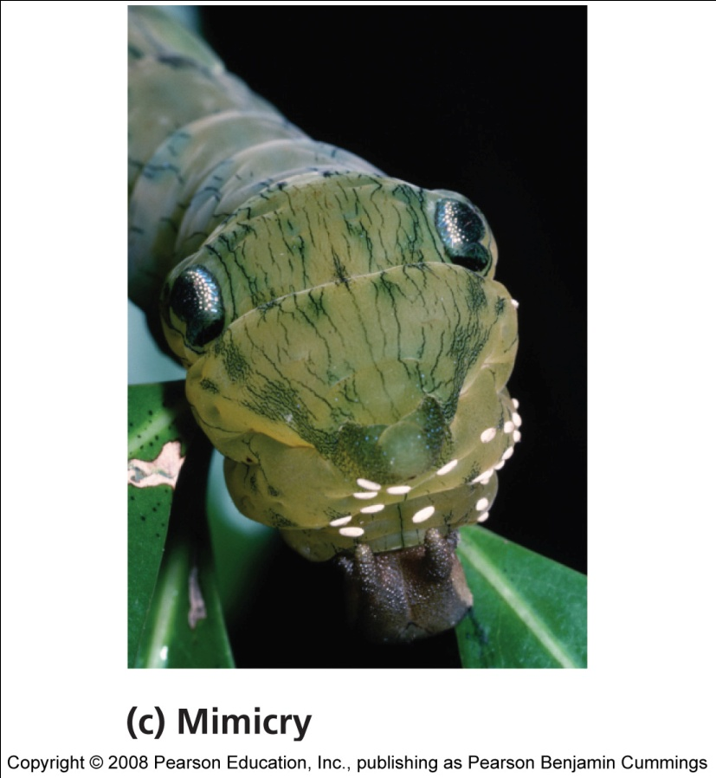
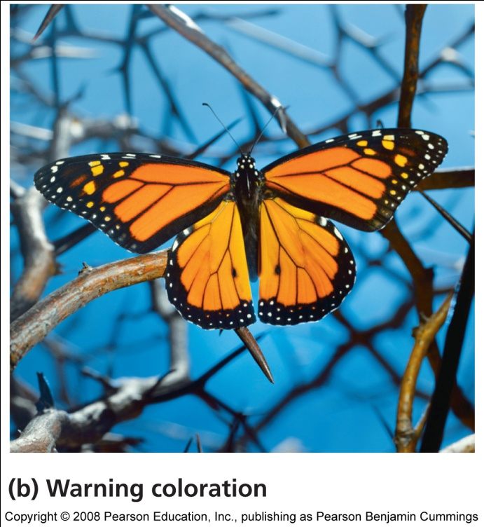
Organisms evolve defenses against being eaten

Slide 15
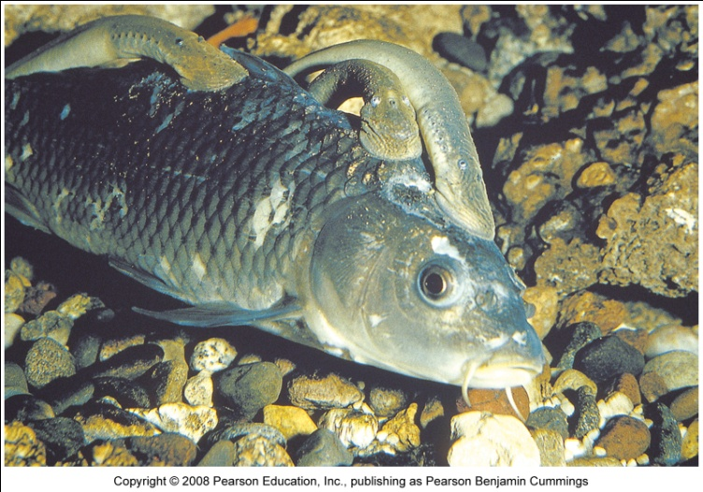
Parasites exploit hosts
Parasitism = a relationship in which one organism (parasite) depends on another (host) for nourishment or other benefit while harming the host
Some species live within the host
  Disease pathogens, tapeworms, insects (parasitoids)
Others live on, are free-living, or have infrequent contact with their hosts
  Ticks, sea lampreys
Notes:
15

Slide 16
Coevolution
Coevolution = hosts and parasites become locked in a duel of escalating adaptations
  Has been called an “evolutionary arms race”
  Each evolves new responses to the other
  “The Red Queen” hypothesis
  It may not be beneficial to the parasite to kill its host
Notes:
16

Slide 17
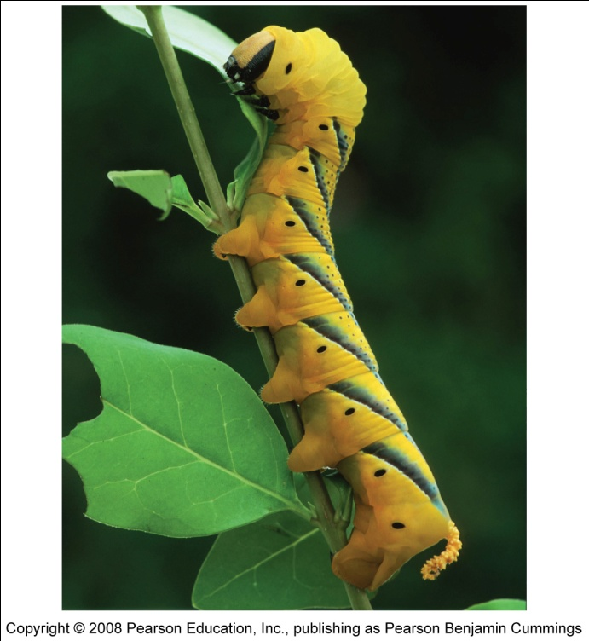
Herbivory
Exploitation in which animals feed on the tissues of plants
  Widely seen in insects
  May not kill the plant, but affects its growth and survival
Defenses against herbivory include
  Chemicals: toxic or distasteful parts
  Physical: thorns, spines, or irritating hairs
  Other animals: protect the plant
Notes:
17

Slide 18
Mutualism
Two or more species benefit from their interactions
  Microbes within digestive tracts, ex: termite
  Pollination = bees, bats, birds and others transfer pollen from one flower to another, fertilizing its eggs
Notes:
18

Slide 19
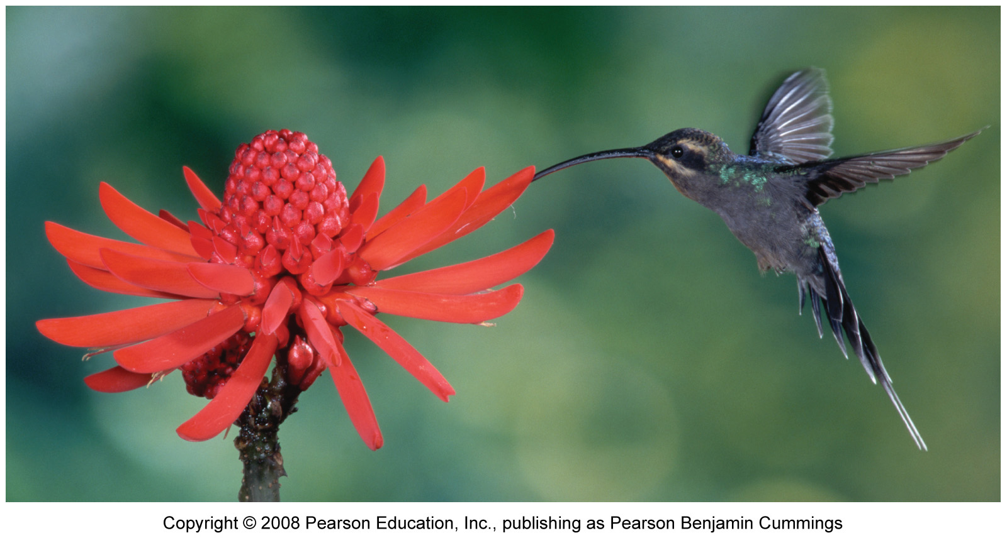
Pollination
In exchange for the plant nectar, the animals pollinate plants, which allows them to reproduce
- bees pollinate 73% of our crops
Notes:
19

Slide 20
Relationships with no effect on one member
Commensalism = a relationship in which one organism benefits, while the other remains unaffected
  Facilitation = plants that create shade and leaf litter allow seedlings to grow
  Example: A hermit crab taking up residence in an empty seashell.
  Example: A spider building a web on a tree.
Notes:
20

Slide 21
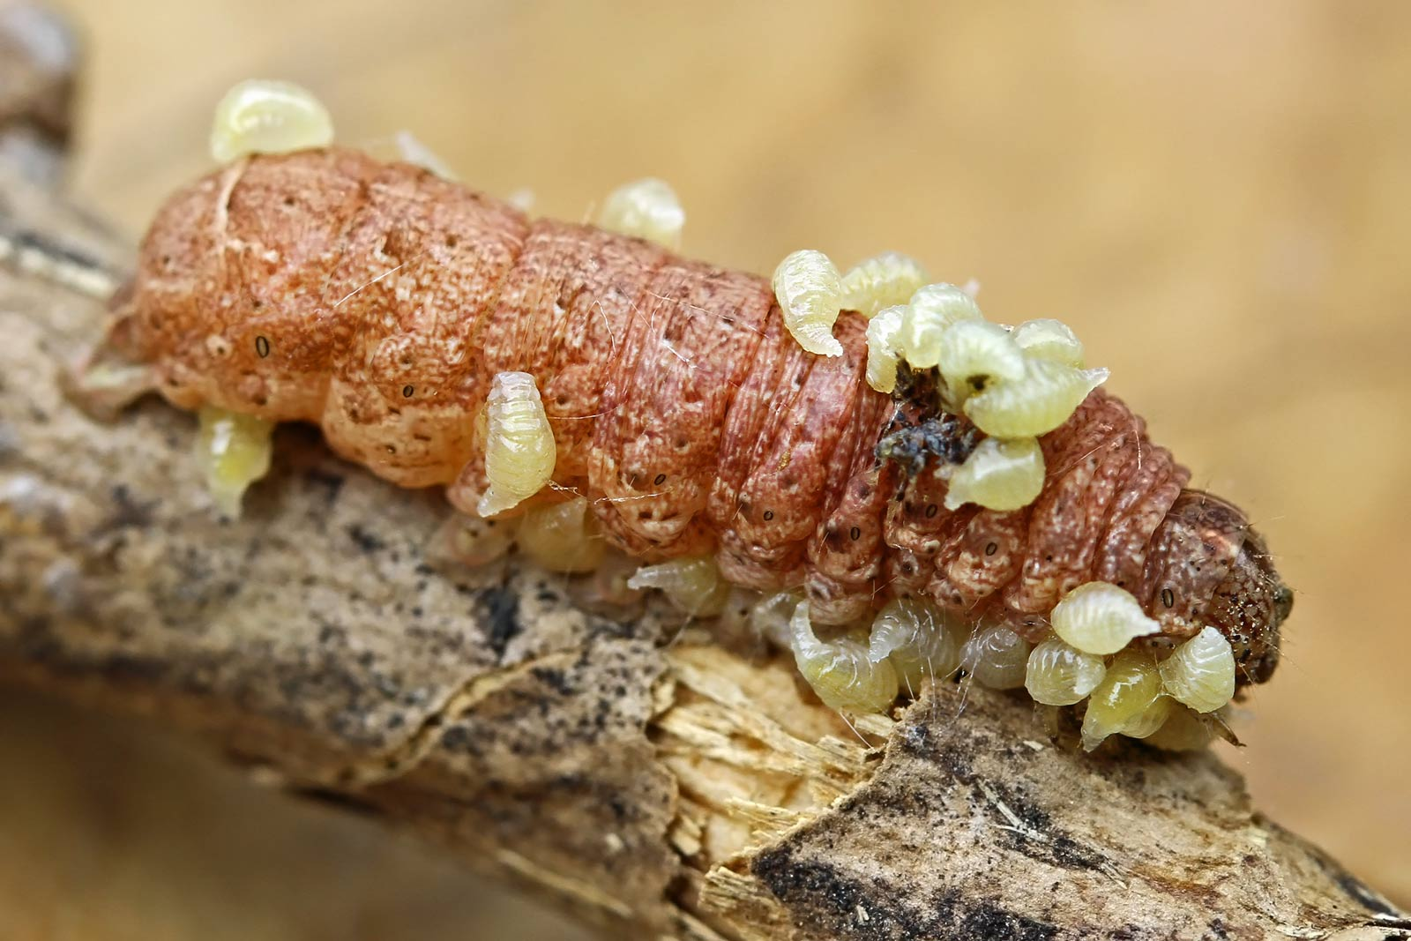
Parasitism

Slide 22
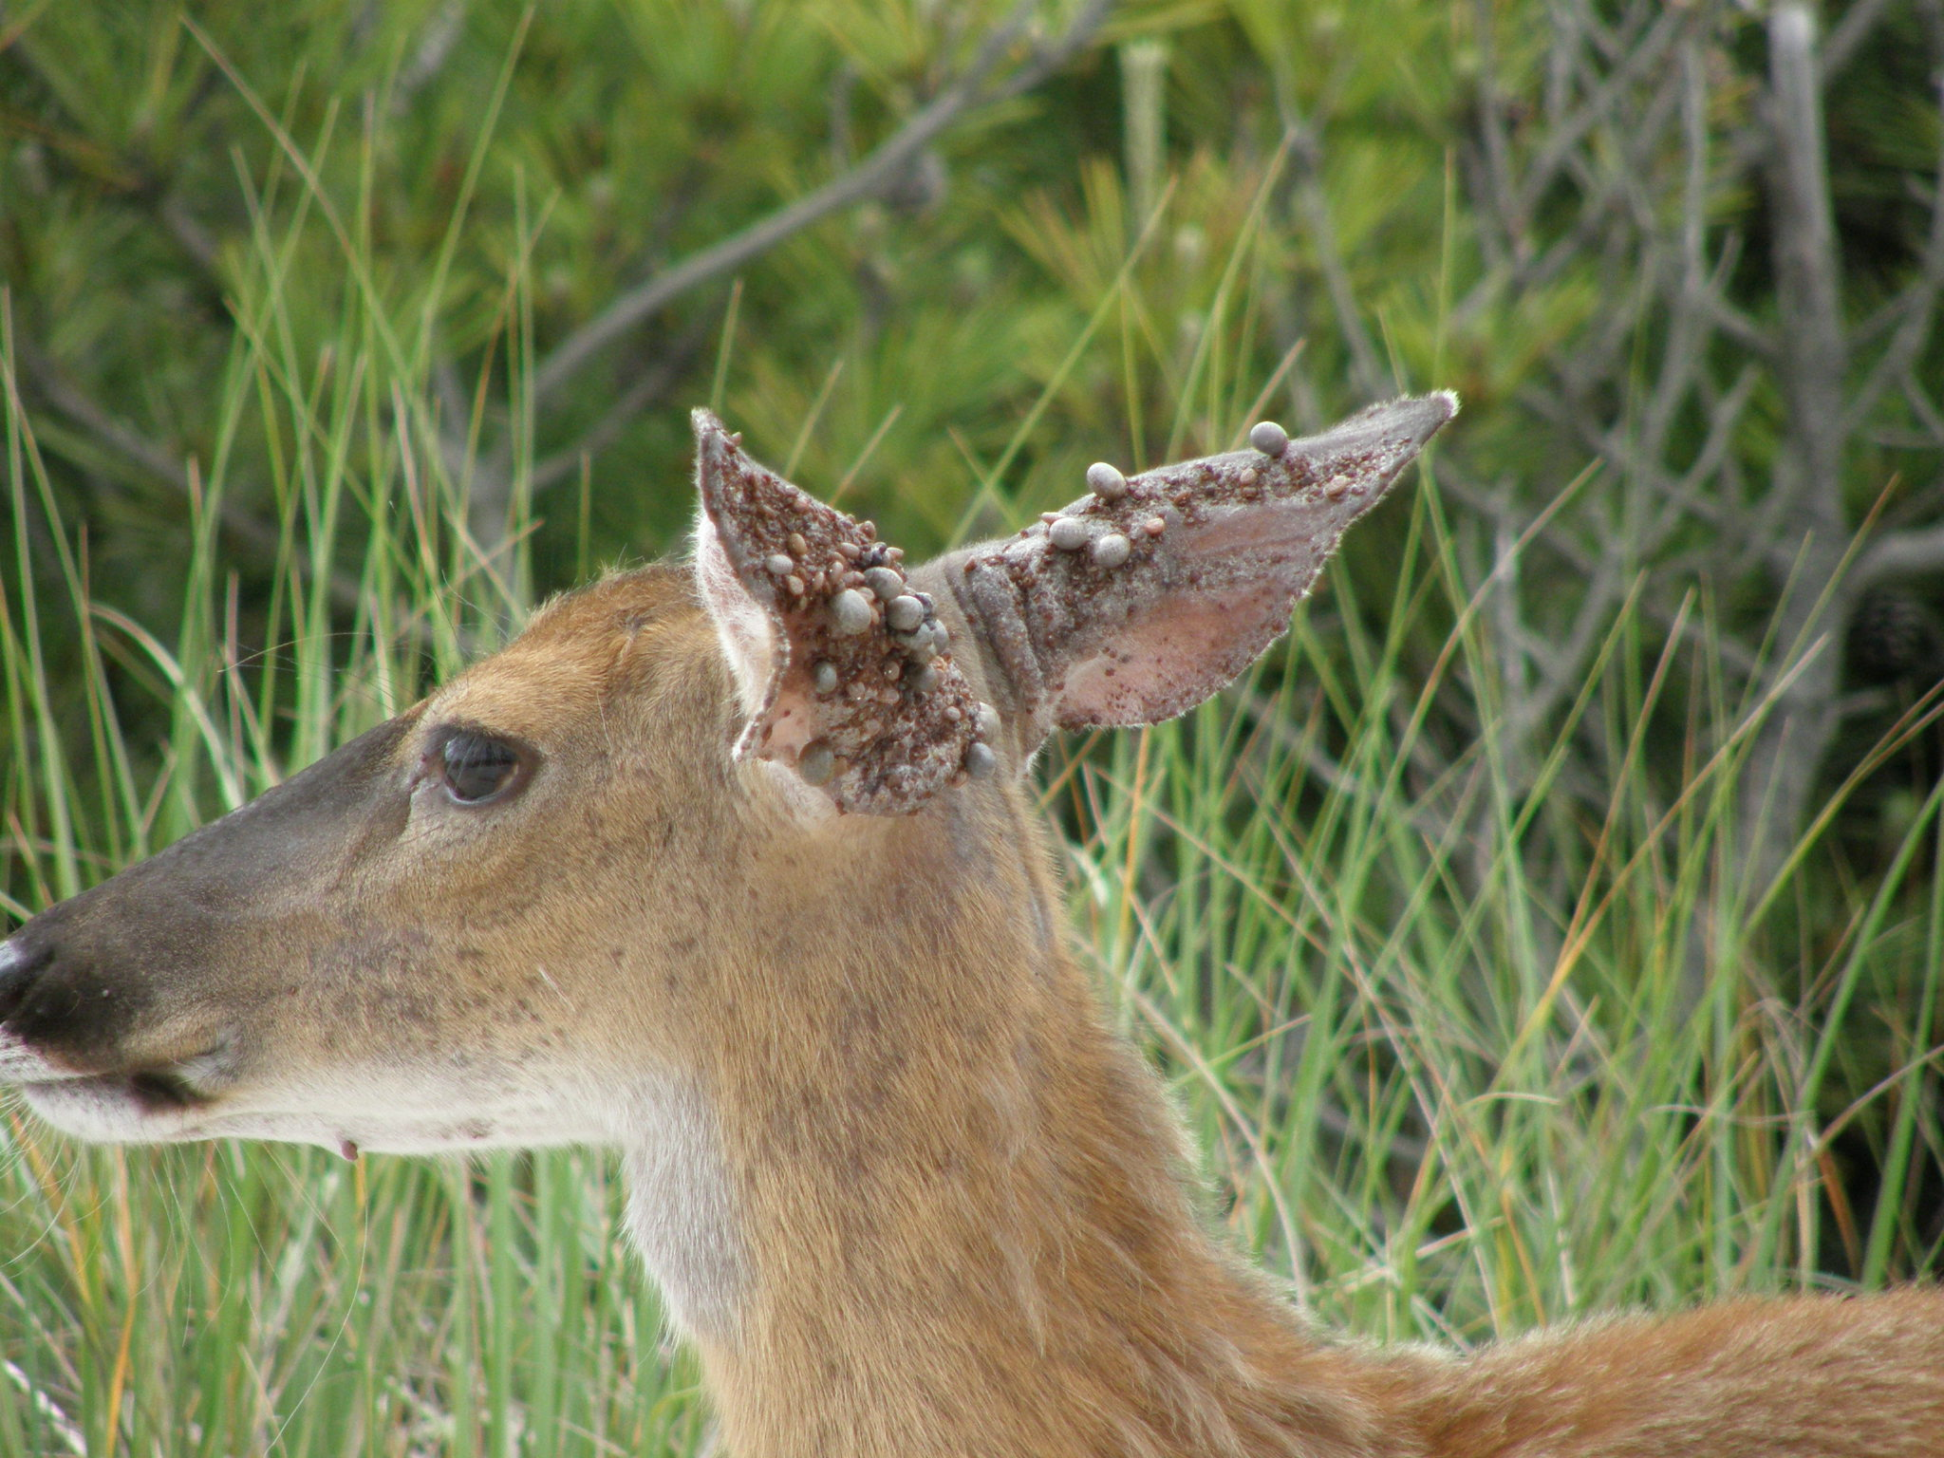
Parasitism

Slide 23
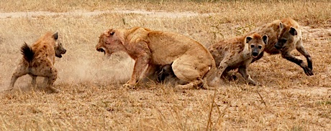
Interspecific Competition

Slide 24
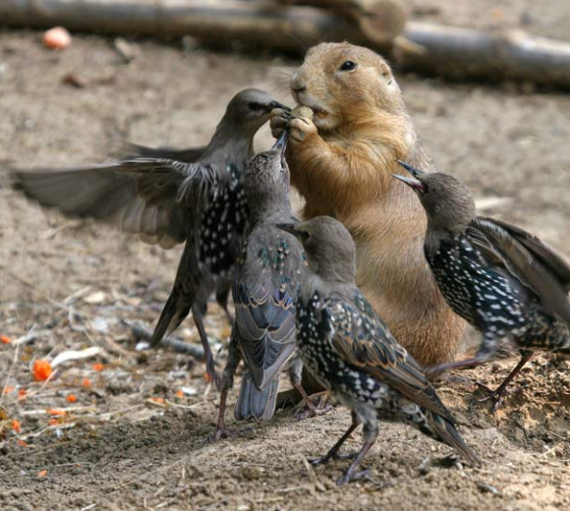
Interspecific Competition

Slide 25
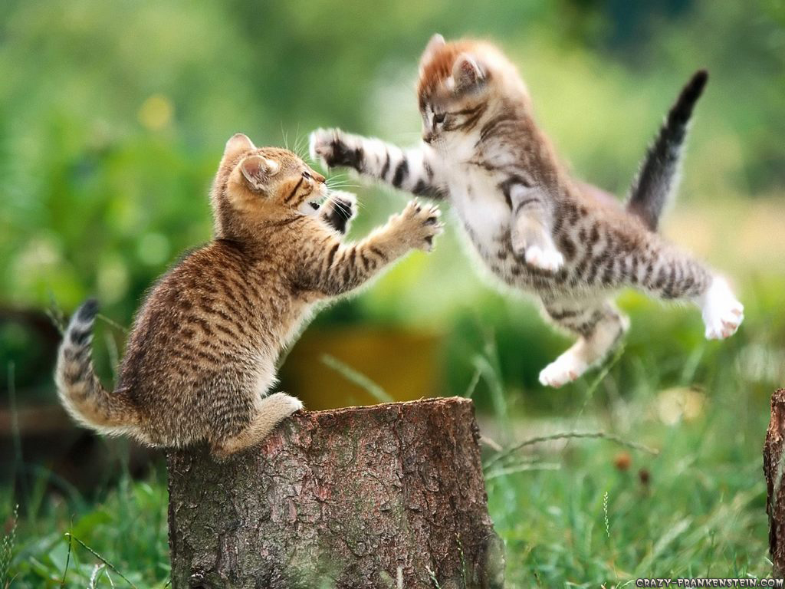
Intraspecific Competition

Slide 26
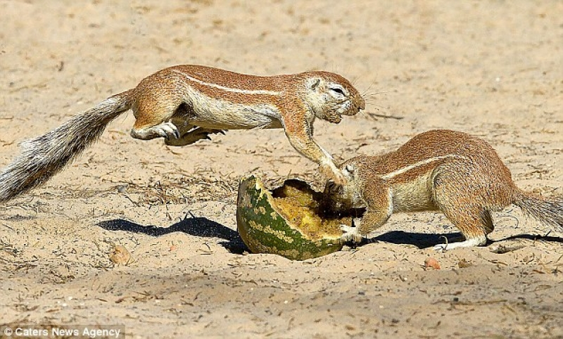
Intraspecific Competition

Slide 27
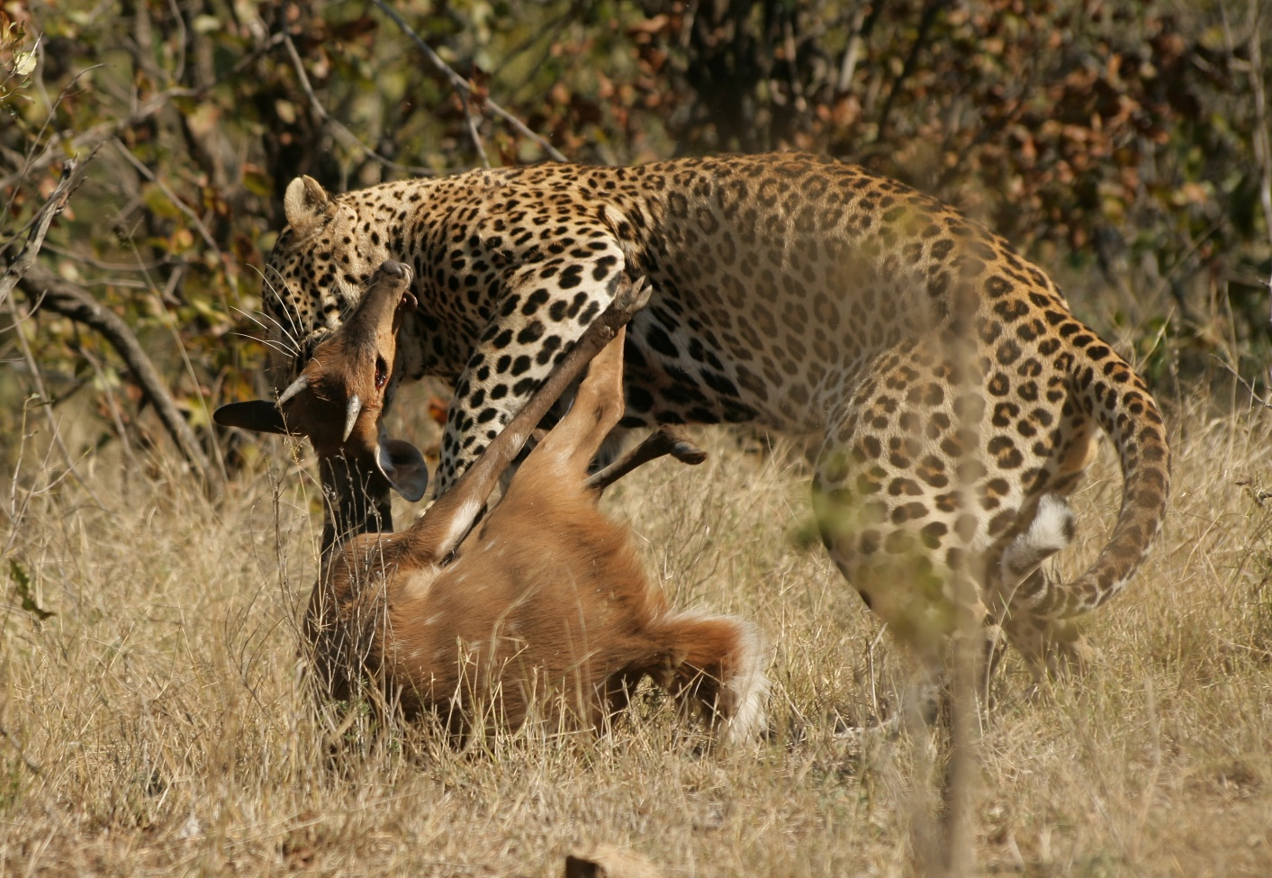
Predation

Slide 28
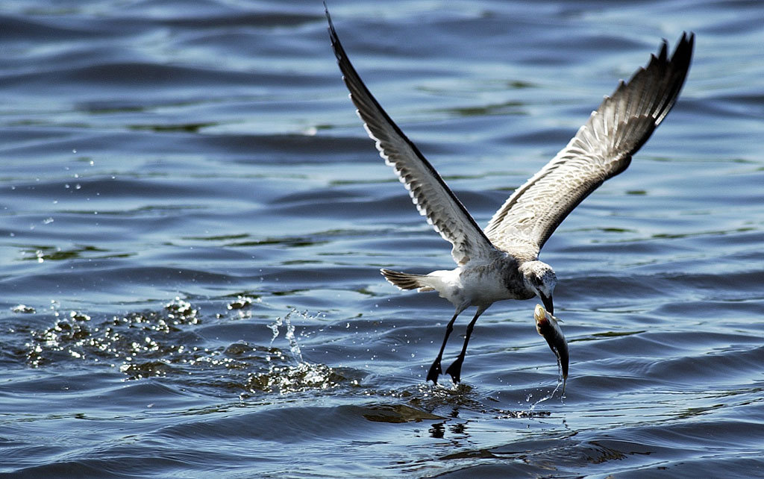
Predation

Slide 29
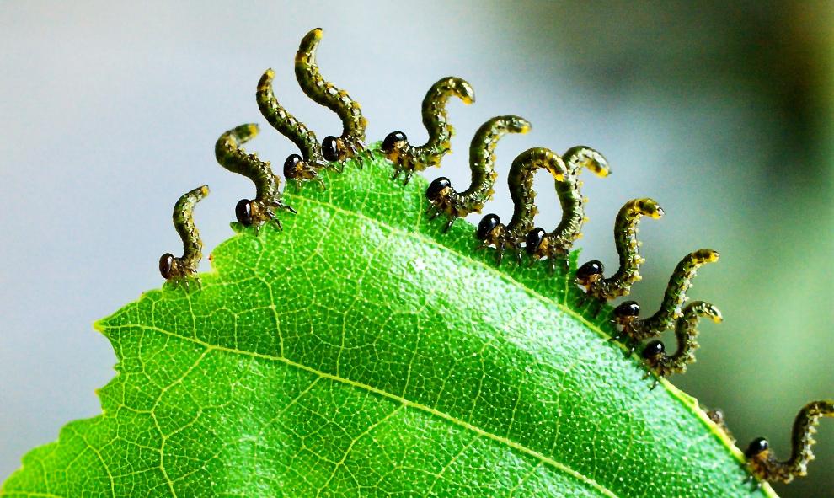
Herbivory

Slide 30
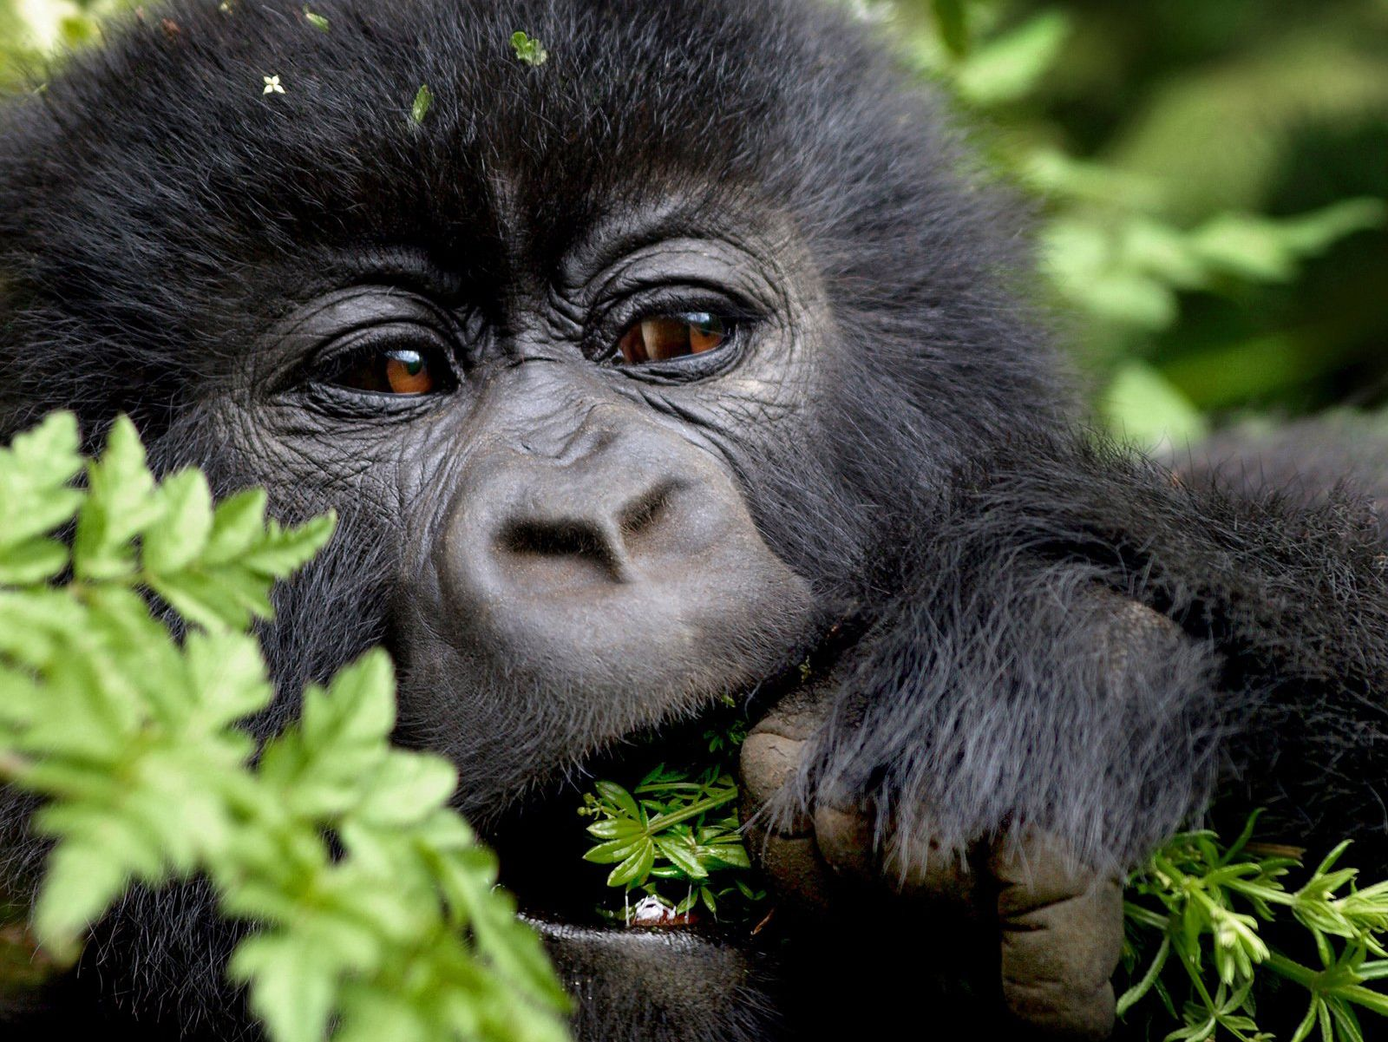
Herbivory

Slide 31
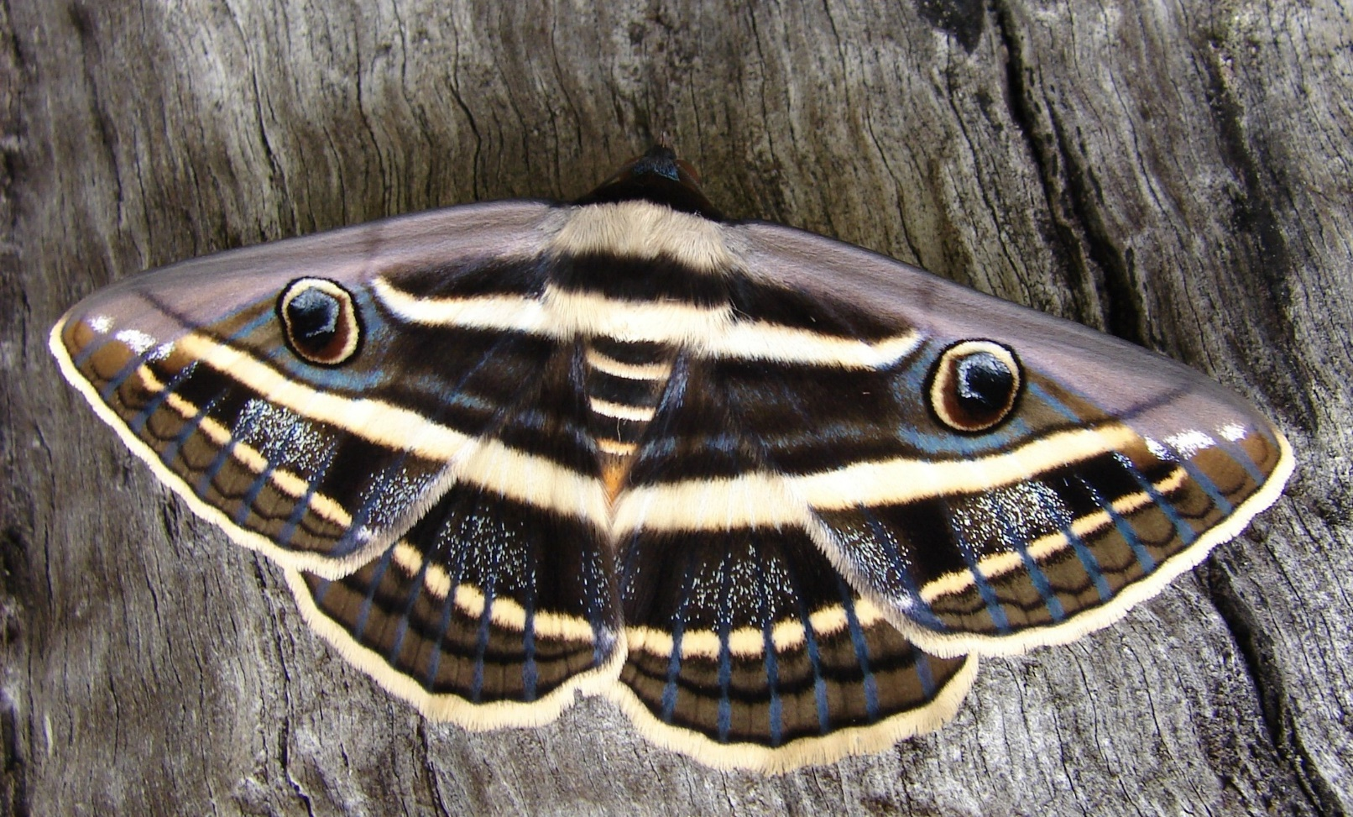
Mimicry

Slide 32
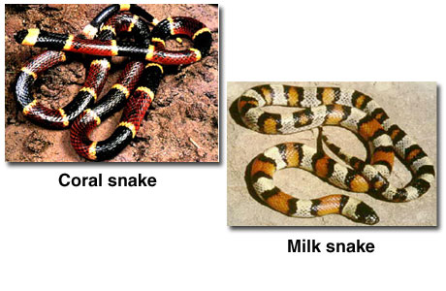
Mimicry

Slide 33
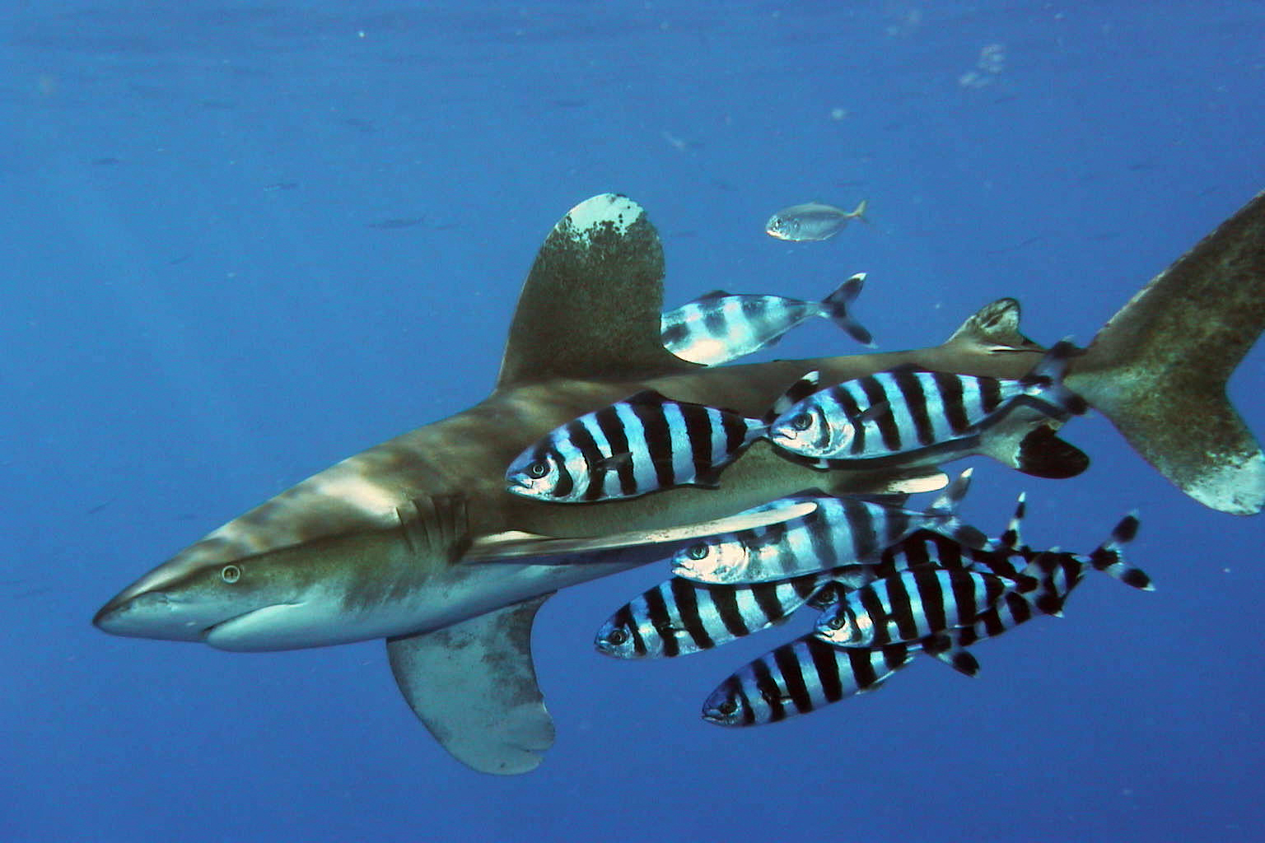
Commensalism

Slide 34
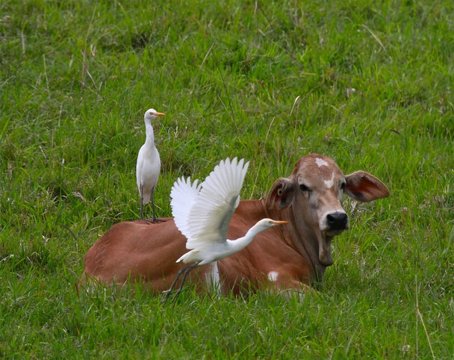
Commensalism

Slide 35
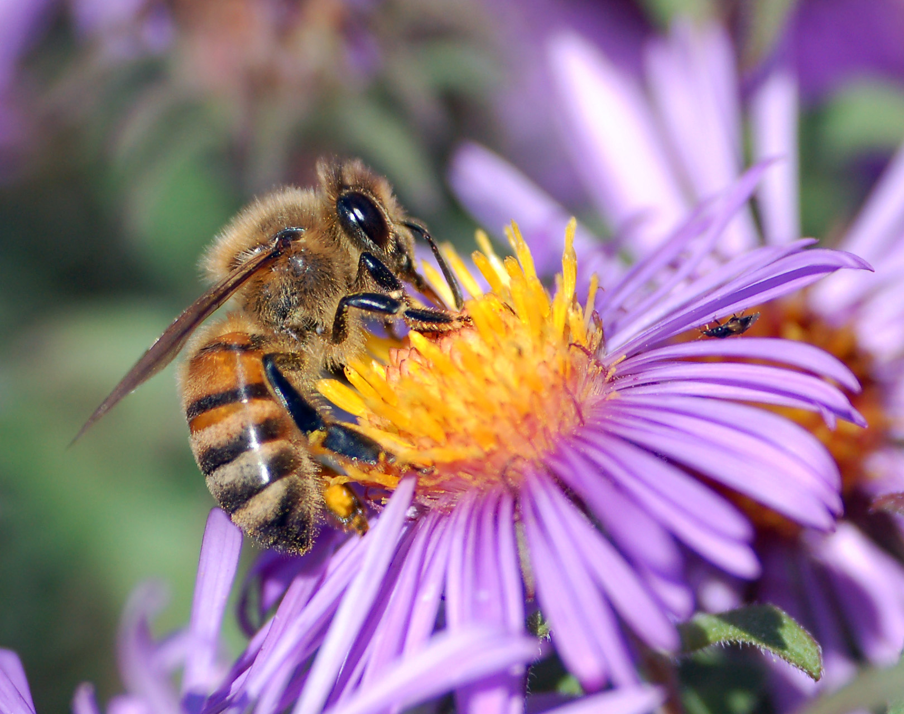
Mutualism

Slide 36
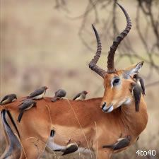
Mutualism

