Slide 1
Mapping the Impact
{Earth Systems & Resources

Slide 2
Objectives
Identify resources, processes, and impacts embodied in material goods
Analyze interconnections among lifestyle, population, economy, and environment
Determine ways to reduce ecological footprint and other impacts associated with material goods

Slide 3
What is Ecological Footprint?
What is Ecology?
the branch of biology dealing with the relations and interactions between organisms and their environment, including other organisms.
What is Footprint?
A step/print that you leave behind

Slide 4
What is Ecological Footprint?
The term “ecological footprint” refers to the area of the earth’s productive surface, both land and sea, that it takes to support a person’s or a population’s lifestyle. Ecological footprint includes natural resources needed from the environment, plus space for infrastructure, recreation, and waste disposal. A more resource-intensive lifestyle results in a larger ecological footprint.

Slide 5
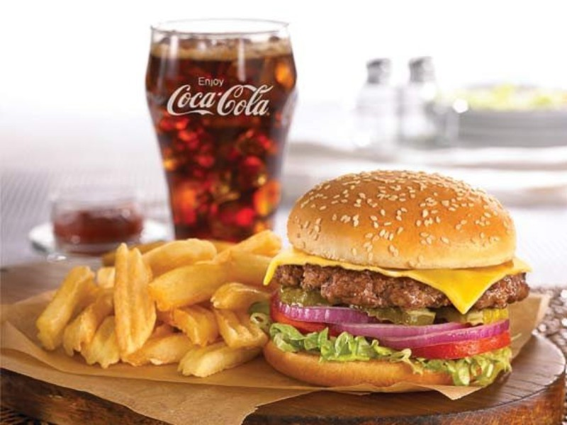
Think about it
Raise your hand if you have eaten a hamburger in the last week?
Read the “Hamburger, Fries, and a Cola” article. Write down the resources required to produce the meal and the impacts it has on the environment.

Slide 6
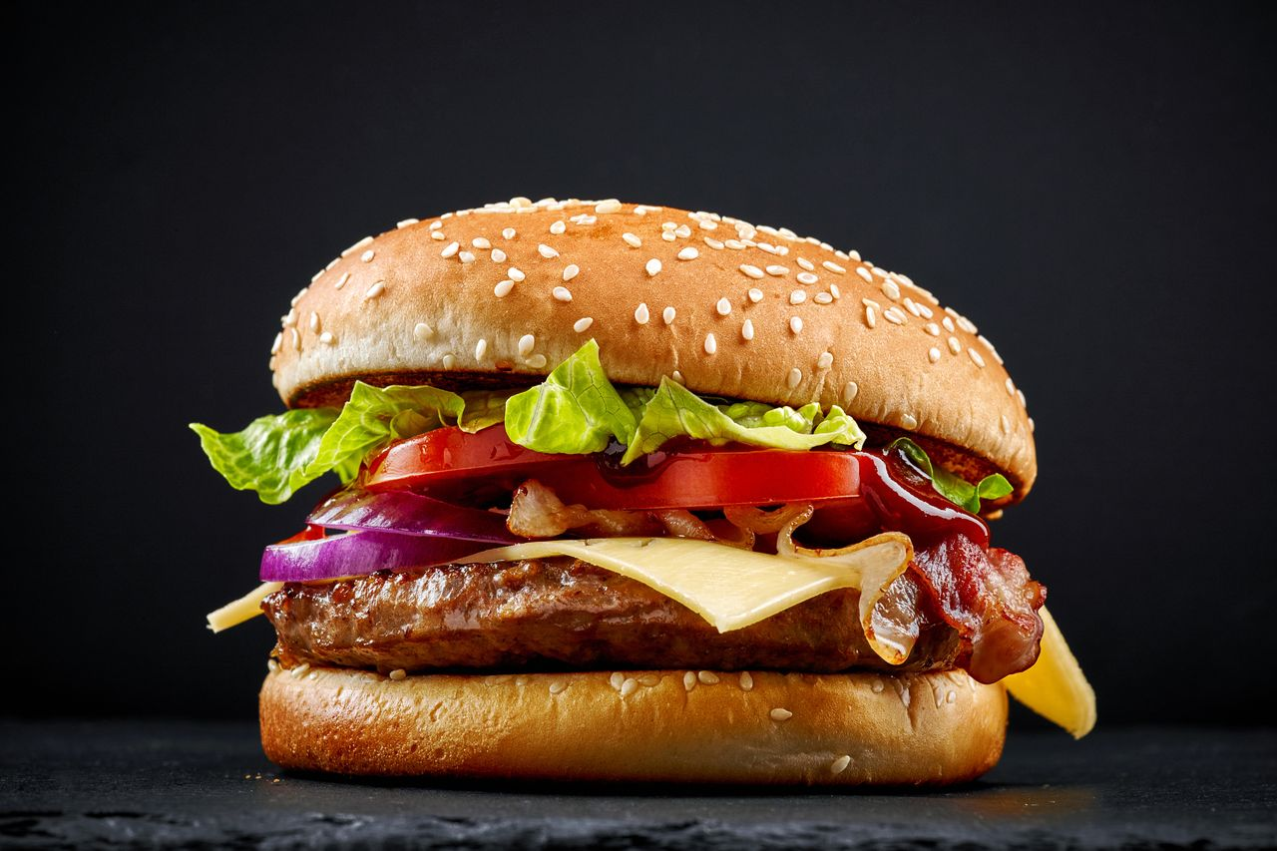
Notes:
Create a “mind map” with the class by asking them:
Ask them what basic ingredients are needed to create a hamburger. (e.g., cow, bun)—Draw or write student answers around the hamburger.
There are several steps required to raise the cow. What are they? (e.g., grazing land, feedlot)—Write student answers on your example.
Between the cow and the Burger, what else happens? (e.g., slaughterhouse, processing/grinding the meat, transportation of the beef to the restaurant, the energy to heat the stove to cook the burger)—Write student answers on your example.
What impacts result from each of the processes and technologies required to produce the hamburger? (e.g., soil erosion, pesticide runoff, climate change, high injury rates among workers)— Include these impacts on your diagram wherever appropriate.
Lastly, have students consider additional impacts that have not yet been shared, perhaps ones beyond those mentioned in the reading. What are some impacts of hamburger consumption on people and societies, including people involved in producing it and people who consume it? (e.g., safety concerns for workers, health concerns from consumption, waste from disposable wrapping)—Write these impacts on your diagram where they seem most appropriate.
What positive consequences of producing and consuming the hamburger, such as economic benefits. Include these on your diagram in a way that distinguishes them from negative impacts (such as by writing them in a different color.)

Slide 8
Brainstorm
In groups, brainstorm and diagram all of the resources, processes, and impacts associated with the everyday object passed out to your group. These are items such as clothing or a piece of sports equipment.
You have 20mins to make an “Impact Diagram”
Notes:
There is no single “right” way to do this activity. A simple web diagram could include lines or arrows connecting the various components of an item to all of the related inputs and impacts.

Slide 9
Create a List
You have 5 mins to create a list with your group, of ways to decrease the ecological footprint of this item.
Note: You do not need to give up everything you like, but rather should focus on positive ways to reduce their impacts.
For example, instead of saying that people should never drive cars, they could suggest that people ride a bike or carpool to school when possible.

Slide 10
Present Diagrams
What is your Item?
What are the negative impacts on the people and the planet?
What are the positive impacts on the people and the planet?

Slide 11
Reflect
How is the ecological footprint of a person’s lifestyle connected to social and economic impacts?
Would the production, use, and disposal of these everyday items be sustainable if only a small number of people purchased the items?
How would the impacts associated with an item change if everyone in the world purchased or used it?
Does lessening our impacts necessarily mean reducing our quality of life? Why, or why not?
How might businesses be encouraged to produce these items in ways that have more positive impacts on the environment and on people?
Often negative impacts associated with an item are not paid directly by the people who purchase and use the items. Who might end up paying for those impacts? Why do you think these impacts are not included in an item’s purchase price?

