Slide 1
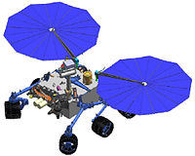
Life on Mars?
Video
If you were to design a Rover looking for life on Mars, what are five things you would test for?
Choose one of your tests. How would you design your Rover so it could perform this test?
Draw your design in your notebook. Explain how it will work.
On your desk are three samples of soil, some sugar, and some warm water. Design a test using these materials to determine which sample contains life.
In your notebook write a procedure
Write down any observations you make.
In your notebook, write a Claim, Evidence, Reasoning (CER) about your findings.

