Slide 1
Homeostasis
What does it mean?

Slide 2
Write this down!
Homeostasis: Greek for “staying the same”
body maintains a stable internal environment.
The hypothalamus is a part of the brain that helps the body maintain homeostasis.
located in the brain just above the brain stem
a group of neurons that forms the primary link between the nervous system and the endocrine system.

Slide 3
This small part of the brain is responsible for regulating many key body processes
internal body temperature,
hunger,
thirst,
blood pressure,
daily (circadian) rhythms.

Slide 4
negative feedback mechanisms
Write this down!

Slide 5
Negative Feedback mechanisms
Negative feedback mechanisms are found in the regulation of blood pressure, heart rate, and internal temperature controls.
For example, the normal internal temperature for the human body is approximately 98.6˚F. If the body temperature rises because of exercise, the body will start to try and cool itself off.

Slide 6
This happens through coordination between the hypothalamus and the various body systems that are affected. Signals are sent that allow blood vessels to return to the normal state, sweat to be produced, pores to be dilated, and heart and breathing rate to normalize.
This is very similar to the way a thermostat works. When the temperature of a room becomes too warm, the thermostat will switch on the air conditioning and cool the room. When the room temperature reaches a set desired temperature, the system turns off.

Slide 8
positive feedback mechanisms
Write this down!

Slide 9
Positive Feedback mechanisms
A mechanism that is much rarer in a healthy body.
Instead of restoring the body to a normal state, the positive feedback mechanism causes an even greater change.
An example of positive feedback can be found in the release of oxytocin, a hormone that intensifies the contractions that take place during childbirth. As the baby’s head is ready to move out of the mother’s body, oxytocin increases and the levels of contractions increase thus pushing the baby out. In this instance, the body responds to an event with more “force” or in a stronger way.

Slide 10
Write a CER!!!
Make a claim about positive and negative feedback mechanisms.
Claim: Positive and negative feedback mechanisms keep the body healthy.
Use evidence and reasoning given in class in your notes to support your claim.

Slide 11
Osmosis
a special form of diffusion involving water moving across a selectively permeable membrane.
hypotonic
hypertonic
Isotonic pressure (look in index)
osmotic pressure (index – osmosis page 224)

Slide 12
Passive transport
Passive transport does not require the cell to expend any energy
involves a substance diffusing down its concentration gradient across a membrane. A concentration gradient is a just a region of space over which the concentration of a substance changes, and substances will naturally move down their gradients, from an area of higher to an area of lower concentration.

Slide 37
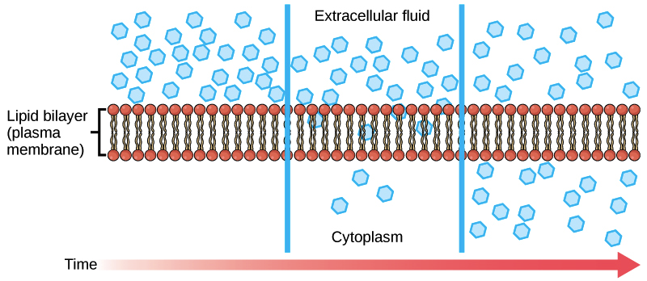
https://www.khanacademy.org/science/biology/membranes-and-transport/passive-transport/a/diffusion-and-passive-transport

Slide 38
Active transport
To move substances against a concentration or electrochemical gradient, the cell must use energy.
Active transport mechanisms do just this, expending energy (often in the form of ATP) to maintain the right concentrations of ions and molecules in living cells
cells spend much of the energy they harvest in metabolism to keep their active transport processes running.
For example, most of a red blood cell’s energy is used to maintain internal sodium and potassium levels that differ from those of the surrounding environment.

Slide 39
ATP
Adenosine tri-phosphate
Needed for active transport
Energy
K and Na pump in cell membrane
Pg 358, 373
“Emphasis is on functions at the organism system level such as nutrient uptake, water delivery, and organism movement in response to neural stimuli.”
“HR response to exercise, stomate response to moisture and temp., and root development in response to water levels.”

Slide 40
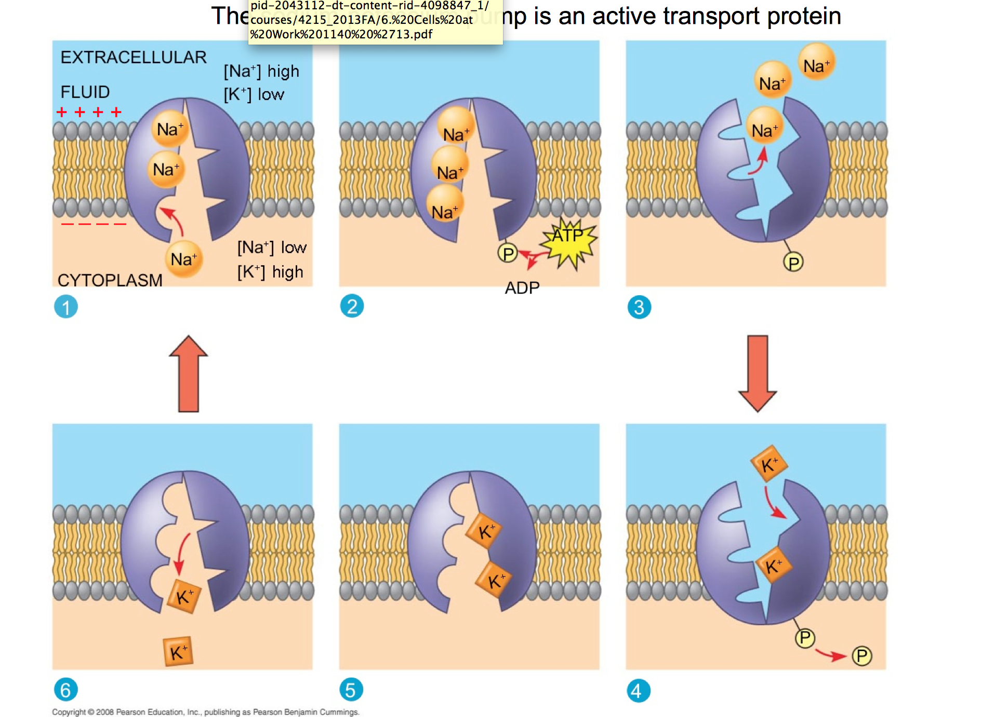

Slide 41
Levels of organization
Atoms Community
Molecules Ecosystem
Organelles Biome
Cells Biosphere
Tissues
Organs
Organ systems
Organism
population

