Slide 1
Everything Is Connected
{Human Population

Slide 2
Introduction
“Everything is connected to everything else” is often called the First Law of Ecology. This activity encourages you to consider the connections between aspects of our natural environment and human society. With the population having reached 7 billion in late 2011 and projected to grow to 9-10 billion by 2050, one cannot ignore the far reaching impact of our numbers on virtually every aspect of life on Earth.

Slide 3
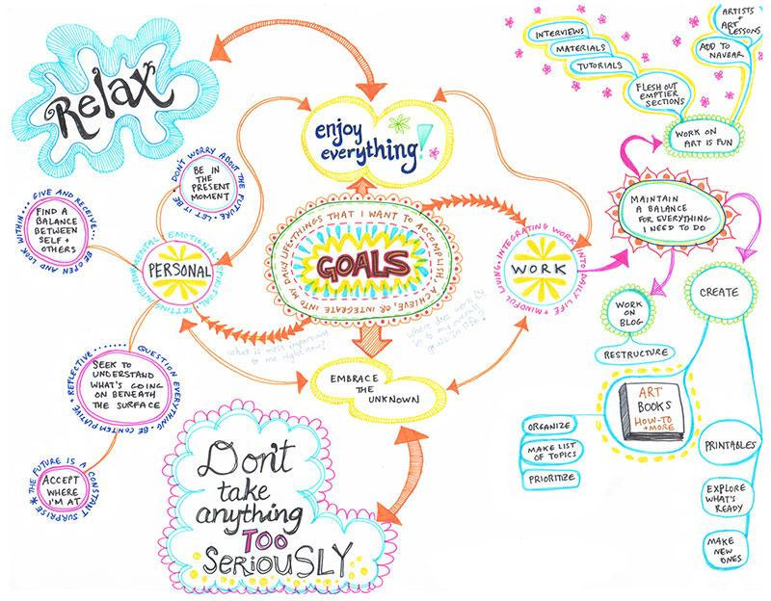
Instructions
In your table teams, you will be creating a mindmap with 7 billion people in the middle.
Think of what might be the environmental, economic or social impacts of more than 7 billion people living on the planet.
“more people”... might mean “more cars on the road” or “more houses.”

Slide 4
Instructions
The cause and effect relationship can be positive, negative or neutral, indicate each event with +, - or =.
You need to have at least 6 connections off the middle, 4 off of the 2nd level connections, 2 off of the 3rd level, and at least 1 off the 4th level.
You have 25 mins to make a colorful and creative mind map.

Slide 5
Instructions
You have 5 mins to walk around the room and look at the other team mindmaps.
Look for similarities and differences.

Slide 6
Reflection
Do you agree with all the connections that have been made?
Were there any connections that you saw on all of the concept maps?
Did you make any connections on your map that you didn’t see on others?
Can you think of any connections that would link the maps together? Would it be possible to combine each group’s concept map into one large web?

Slide 8
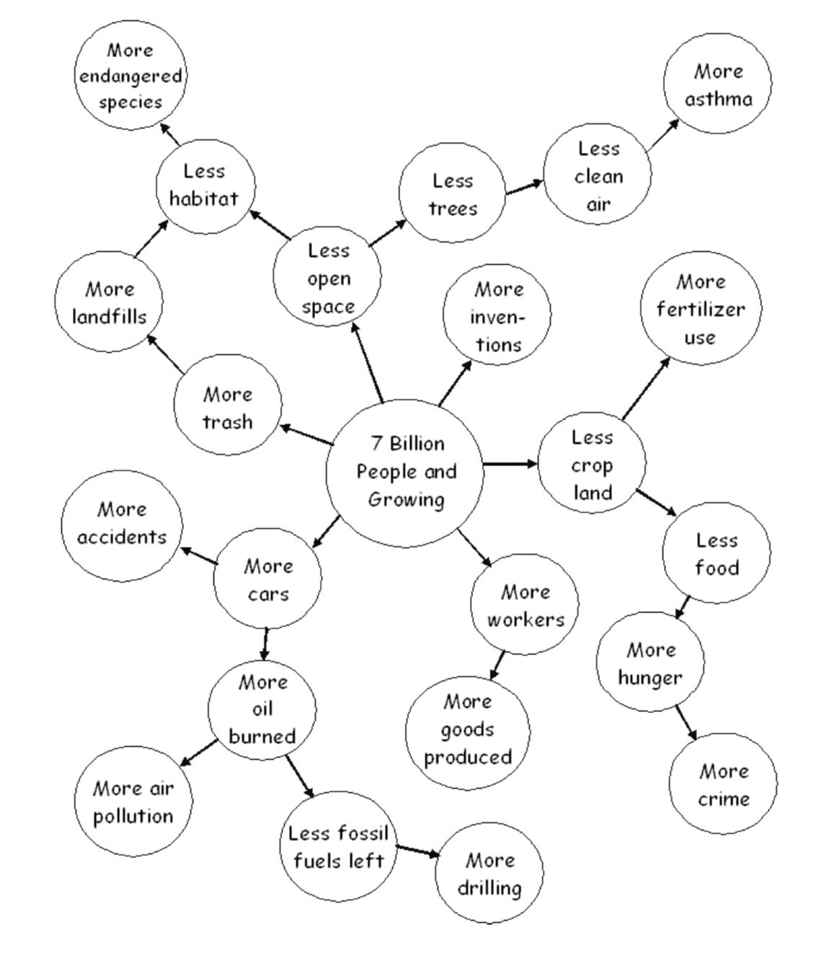
For Teacher Reference

