Slide 1
Environmental Protection AGENCY: EPA
{The Good, the Bad, and the Trump

Slide 2
EPA: The Good

Slide 3
Clean water act
The Clean Water Act (CWA) establishes the basic structure for regulating discharges of pollutants into the waters of the United States and regulating quality standards for surface waters. The basis of the CWA was enacted in 1948 and was called the Federal Water Pollution Control Act, but the Act was significantly reorganized and expanded in 1972. "Clean Water Act" became the Act's common name with amendments in 1972. Source: epa.org

Slide 4
Clean water act
https://nepis.epa.gov/Exe/ZyPDF.cgi?Dockey=P100156H.txt
EPA has regulations regarding the safety of groundwater and drinking water, as well as how states enforce those regulations

Slide 5
Clean Air Act
The Clean Air Act (CAA) is the comprehensive federal law that regulates air emissions from stationary and mobile sources. Among other things, this law authorizes EPA to establish National Ambient Air Quality Standards (NAAQS) to protect public health and public welfare and to regulate emissions of hazardous air pollutants.

Slide 6
Clean Air Act
One of the goals of the Act was to set and achieve NAAQS in every state by 1975 in order to address the public health and welfare risks posed by certain widespread air pollutants. The setting of these pollutant standards was coupled with directing the states to develop state implementation plans (SIPs), applicable to appropriate industrial sources in the state, in order to achieve these standards. The Act was amended in 1977 and 1990 primarily to set new goals (dates) for achieving attainment of NAAQS since many areas of the country had failed to meet the deadlines.

Slide 7
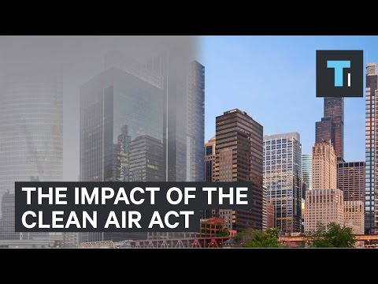

Slide 8
Toxic Substance Control Act
The Toxic Substances Control Act of 1976 provides EPA with authority to require reporting, record-keeping and testing requirements, and restrictions relating to chemical substances and/or mixtures. Certain substances are generally excluded from TSCA, including, among others, food, drugs, cosmetics and pesticides.

Slide 9
Toxic Substance Control Act
TSCA addresses the production, importation, use, and disposal of specific chemicals including polychlorinated biphenyls (PCBs), asbestos, radon and lead-based paint.

Slide 10


Slide 11


Slide 12
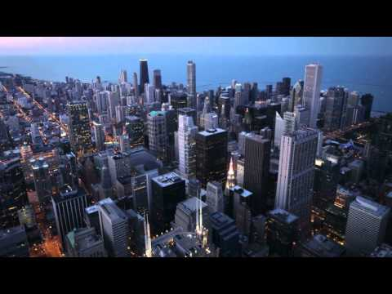

Slide 13
EPA: The Bad

Slide 14
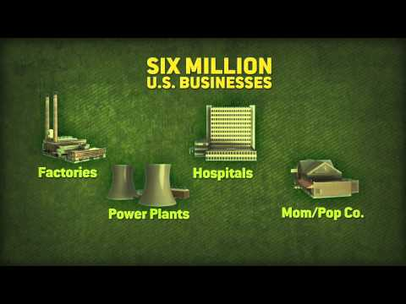
EPA Regulatory Outreach

Slide 15
EPA proposed Water Rule
The Federal Water Pollution Control Act of 1948 was the first major U.S. law to address water pollution. Growing public awareness and concern for controlling water pollution led to sweeping amendments in 1972. As amended in 1972, the law became commonly known as the Clean Water Act (CWA).

Slide 16
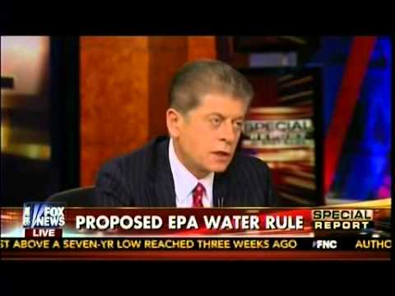
EPA proposed Water Rule 2015

Slide 17
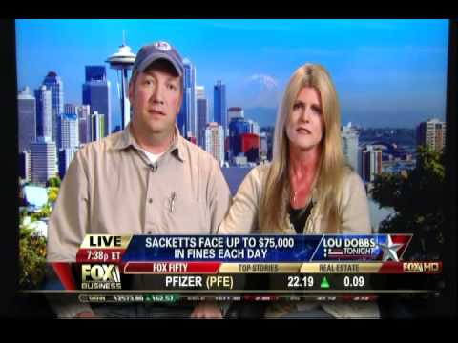
Sacketts Vs. EPA 2012

Slide 18
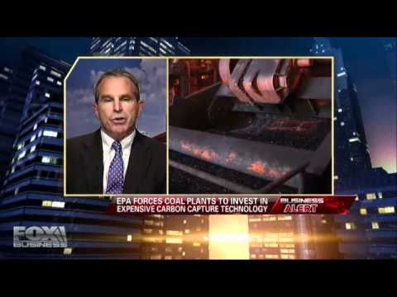
Does EPA Really help the Environment? 2012

Slide 19
EPA: The Trump

Slide 20
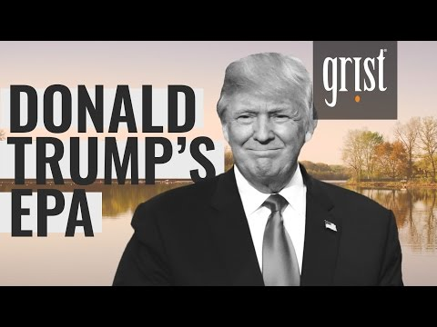
What does the Trump EPA look Like? 2016

Slide 21
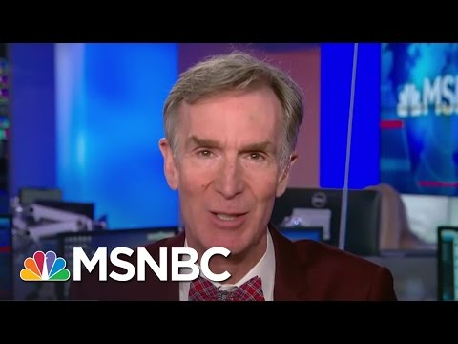
Bill Nye Talks Trump EPA -2016

Slide 22
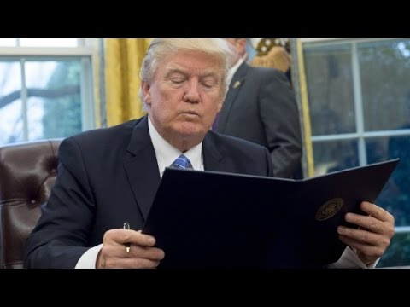
Trump Freezes EPA Grants 1/25/17

Slide 23
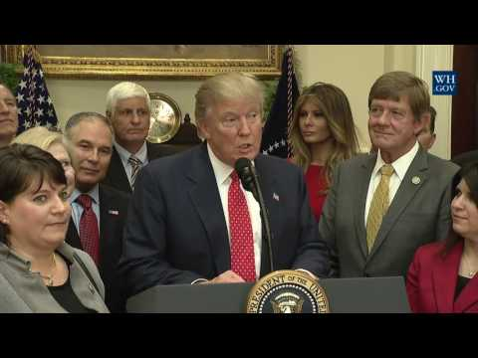
Trump Revokes Clean Water Act, 2/28/2017

Slide 24
Epa pros & cons
PROS:
PROTECT ENVIRONMENT
  WATER, AIR, soil/Toxins
KEEP POLLUTION OUT
KEEP PEOPLE HEALTHY
CONS:
FALSIFY RECORDS FOR THEIR BENEFIT
TRY TO KEEP AS MUCH MONEY AS THEY CAN
HIDE INFO ABOUT SUPERFUND SITES
Too much Power

