Slide 1
DNA

Slide 2
3/2
What comes to your mind when you think of DNA?
What is genetics and why should we know about it?

Slide 3
CENTRAL DOGMA OF MOLECULAR BIOLOGY (How information passes in cells)
http://www.emunix.emich.edu/~rwinning/genetics/pics/dogma.jpg

Slide 4
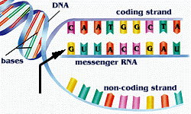
DNA→RNA → PROTEINS Chapters 16 & 17
http://faculty.uca.edu/~johnc/mbi1440.htm
http://www.wappingersschools.org/RCK/staff/teacherhp/johnson/visualvocab/mRNA.gif

Slide 5
Which molecule carries genetic information?
How does bacteria make people sick?
Looking for pneumonia there were 2 strains. S – harmful and R - harmless

Slide 6
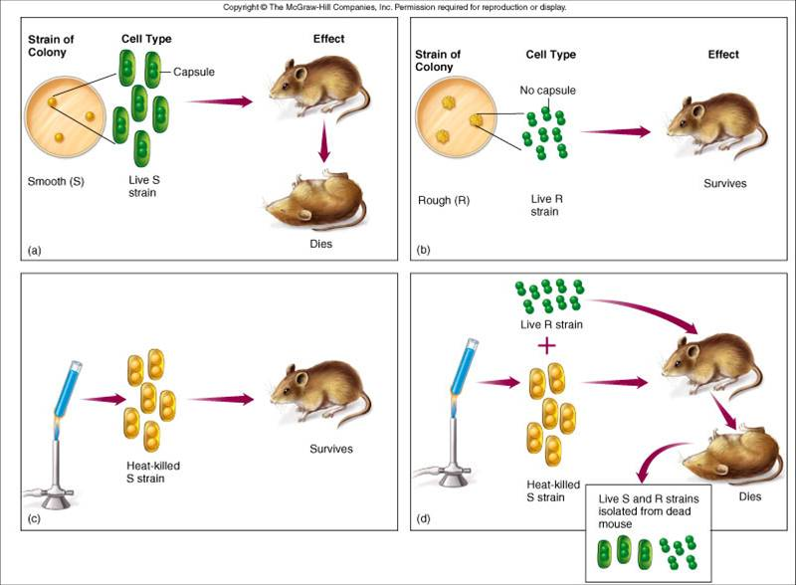
1928- GRIFFITH’s EXPERIMENT
Scientists originally thought PROTEINS had to be the genetic material
12 A
Images from: http://microvet.arizona.edu/Courses/vsc610/mic205/griffith.jpg

Slide 7
Griffith’s Conclusion : something is transformed from dead bacteria to live bacteria
Is it a protein or a nucleic acid? Here comes the Hershey Chase experiment

Slide 8
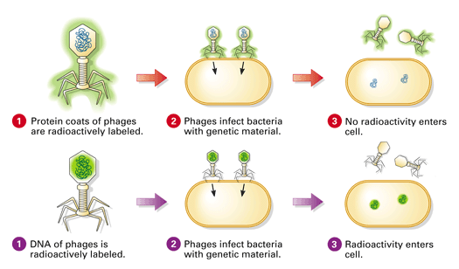
Only Genetic information enters the cell

Slide 9
DNA – nucleic acid joined in a long chains by covalent bonds.
Responsible for storing information, copying information, transmitting information

Slide 10
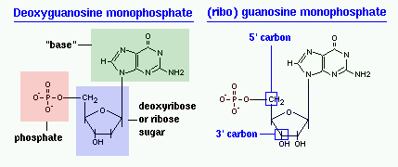
Each nucleotide contains 3 parts
phosphate, deoxyribose sugar, and a base

Slide 11
DOUBLE HELIX
Linus Pauling's Triple helix model
http://www.biosciences.bham.ac.uk/labs/minchin/tutorials/lgdna.html

Slide 12
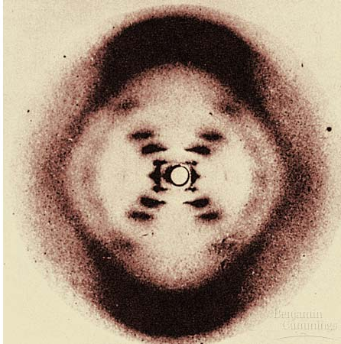
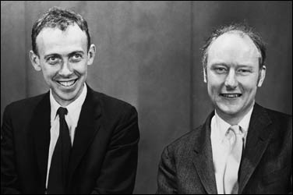
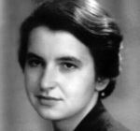
ROSALIND FRANKLIN and MAURICE WILKINS
Analyzed DNA with X-ray crystallography to try
and determine structure of DNA
1953 - JAMES WATSON & FRANCIS CRICK
used Rosalind Franklin’s X-ray crystallography
images (PHOTO 51) to come up with alpha helix
model for the structure of DNA
http://en.wikipedia.org/wiki/Rosalind_Franklin
http://www.time.com/time/time100/scientist/profile/watsoncrick.html

Slide 13
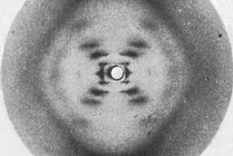
Rosalind Franklin
X-ray crystallography
http://www.youtube.com/watch?v=JiME-W58KpU
Notes:
Rosalind Franklin was a British scientist who helped discover the structure of DNA, but you most likely haven't heard of her. Hank will attempt to fix this gap in your knowledge on today's SciShow:

Slide 14
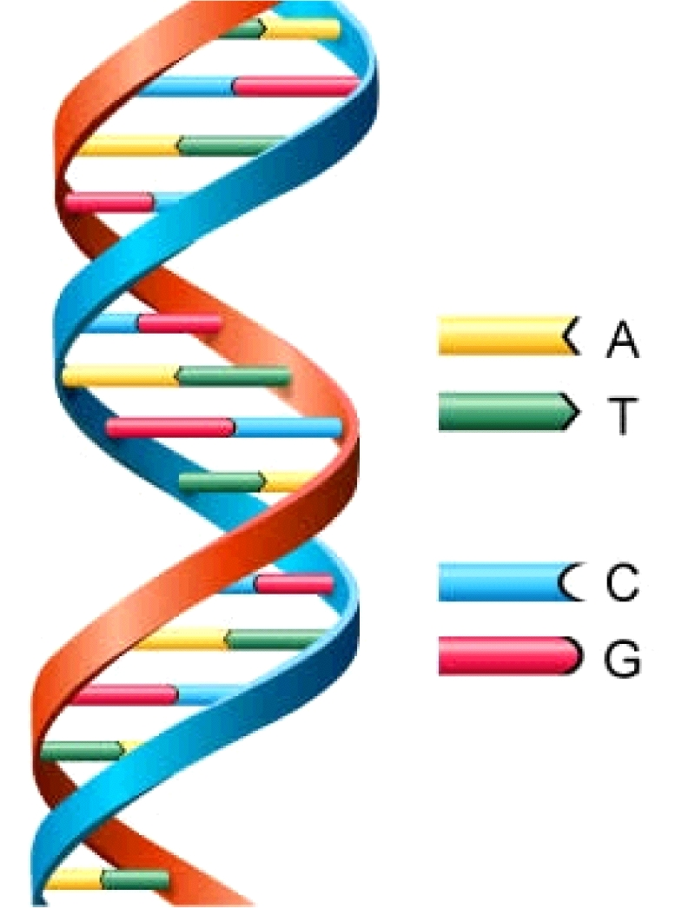
3/3
What are the main parts of a DNA strand?
What are some things you notice about the picture below?
Notes:
Nitrogenous base, deoxyribose sugar, phosphate group

Slide 15
STRUCTURE OF NUCLEIC ACIDS
Arrow from: http://www.harrythecat.com/graphics/b/arrow48d.gif
Built from
NUCLEOTIDE
SUBUNITS
NITROGEN BASES
CAN BE:
ADENINE GUANINE CYTOSINE THYMINE URACIL
Sugar can be DEOXYRIBOSE (DNA) RIBOSE (RNA)
Image by: Riedell

Slide 16
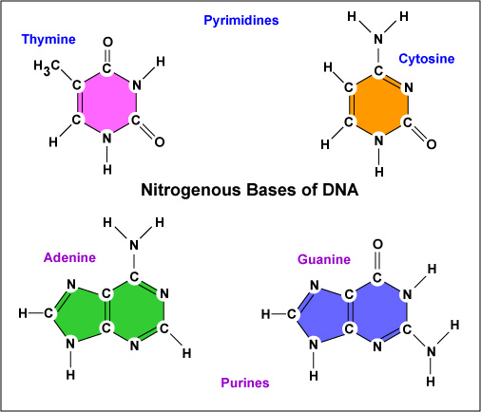
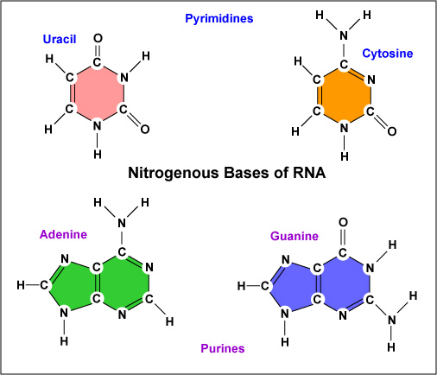
DNA has no URACIL RNA has no THYMINE
PURINES (A & G) have 2 RINGS
PYRIMIDINES (T, C, & U) have 1 RING
http://student.ccbcmd.edu/courses/bio141/lecguide/unit6/genetics/DNA/DNA/fg4.html
http://student.ccbcmd.edu/~gkaiser/biotutorials/dna/fg29.html

Slide 17
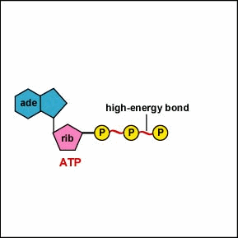
Subunits come in as TRIPHOSPHATES
Splitting of nucleotide triphosphates provides the energy to link the nucleotides
See animation
http://www.cat.cc.md.us/~gkaiser/biotutorials/energy/adpan.html

Slide 18
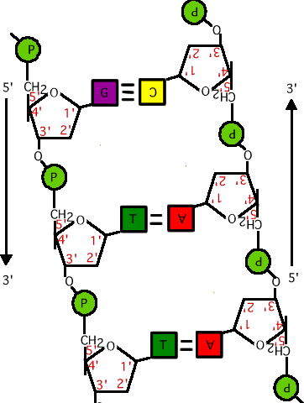
DNA
DOUBLE STRANDED
Strands run ANTIPARALLEL
Backbone = sugars and phosphates
Rungs of ladder = nitrogen bases
Hydrogen bonds hold sides of ladder together
http://staff.jccc.net/pdecell/proteinsynthesis/antiparralell.gif

Slide 19
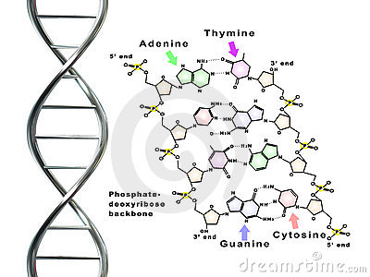
3/3
What is the complimentary strand of a sequence that reads TGACTG.
If you could design a model of DNA, what would you need?

Slide 20
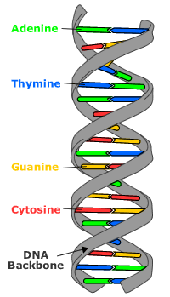
Erwin Chargaff analyzed DNA from different organisms and found
CHARGAFF’s RULES:
Complementary base pairing A = T G = C
Now know its because:
A always bonds with T
G always bonds with C
A Purine always bonds to a Pyrimidine

Slide 21
Candy model DNA write up
You need to turn in a write up to get any credit for the lab.
In 5-6 sentences describe what each part of your Candy DNA represents using the Vocabulary and concepts learned in class. How is your candy DNA like real DNA? How is it different?
Vocabulary: Model, nucleotide, Complementary base pair rule, hydrogen bonds, rungs, Sugar, phosphate, nitrogen- base, double helix, ladder, antiparallel, genetic information,

Slide 22
3/4
Model, nucleotide, Complementary base pair rule, hydrogen bonds, rungs, Sugar, phosphate, nitrogen- base, double helix, ladder, antiparallel, genetic information
Choose two of the vocabulary words from yesterday to craft a statement about your candy DNA.
Where on your model would you find a hydrogen bond?

Slide 23
Chromosome Structure in Prokaryotes
Approximately 5 million base pairs 3,000 genes
Chromosome
E. coli bacterium
Bases on the chromosome
DNA molecule in bacteria single circular loop.
How do you think our DNA is different?
© Pearson Education Inc, publishing as Pearson Prentice Hall. All rights reserved

Slide 24
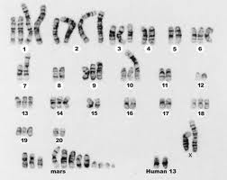
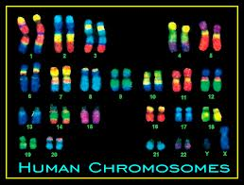
Humans have 23 pairs of chromosomes!
Bacteria have one.

Slide 25
3/3
Turn in DNA molecule write up!
What does it mean to script something?
Why do you think it is useful to know the sequence of our DNA?
Would you take a test that could tell you more about your future health?

Slide 26
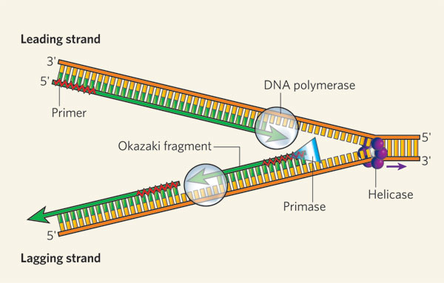
3/4
What is the role of DNA in your cell?
What would need to happen for the DNA to replicate itself?
Notes:
Store, copy, transmit information,

Slide 27
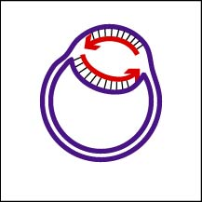
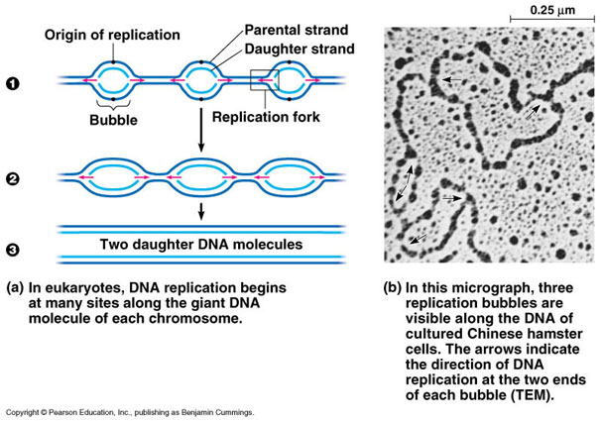
http://student.ccbcmd.edu/~gkaiser/biotutorials/dna/fg12.html
Starting place =
ORIGIN OF REPLICATION
Bacteria have one
Eukaryotes-multiple spots
DNA
REPLICATION
FORK

Slide 28
CENTRAL DOGMA OF MOLECULAR BIOLOGY (How information passes in cells)
1. How is DNA like a book?
http://www.emunix.emich.edu/~rwinning/genetics/pics/dogma.jpg

Slide 29
Thought questions
How is DNA like a book?
Describe DNA in your notebook and fill out an exit (see handout)
Notes:
Stores and records genetic information, they may be repli
----- Meeting Notes (3/4/14 10:45) -----
backbone, has story of where you come from
----- Meeting Notes (3/4/14 11:17) -----
#11 -

Slide 30
http://www.youtube.com/watch?v=GcrndR-zdyM
Dna replication
Describe DNA replication in your notes.
Write down the important parts in your notes.
Use your notes to revise your answer for number 11 on the Dna replication assignment
Notes:
Lectures in college go by really fast you use classmates and study buddies to fill in the parts you missed
----- Meeting Notes (3/4/14 11:17) -----
#11= 4 1,2,3 - bonds break, 3,

Slide 31
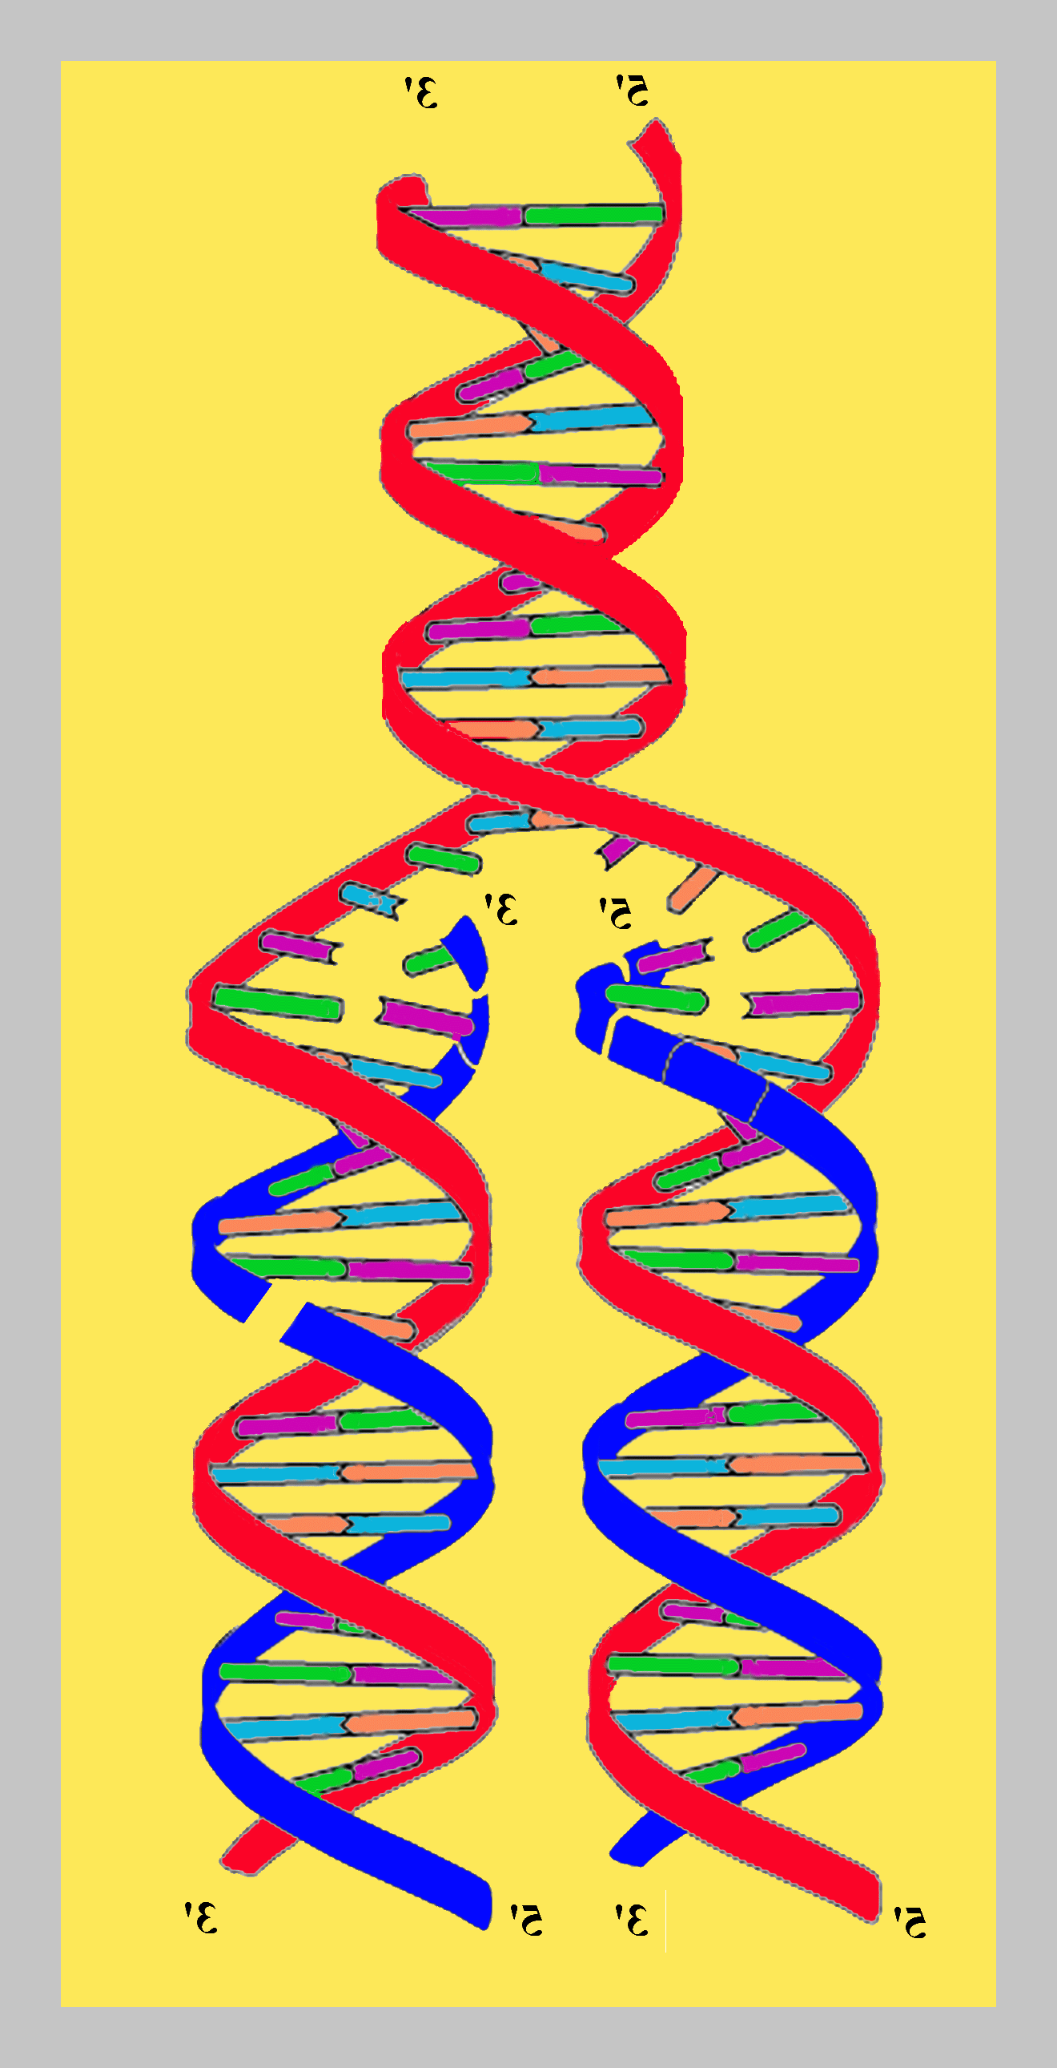
DNA Replication – think about the original strands and the new strands strands
What does the blue line represent?
What does the red line represent?
What is meant by semi-conservative?
http://bio.usuhs.mil/biochem4.html

Slide 32
Rosalind Franklin
X-ray crystallography
http://www.youtube.com/watch?v=JiME-W58KpU
Notes:
Rosalind Franklin was a British scientist who helped discover the structure of DNA, but you most likely haven't heard of her. Hank will attempt to fix this gap in your knowledge on today's SciShow:

Slide 33
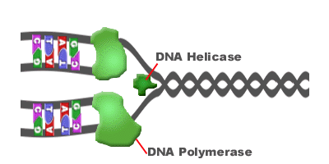
Replication – DNA copying itself
Helicase – splits strand
DNA polymerase – enzyme that joins nucleatides to produce new strands

Slide 34
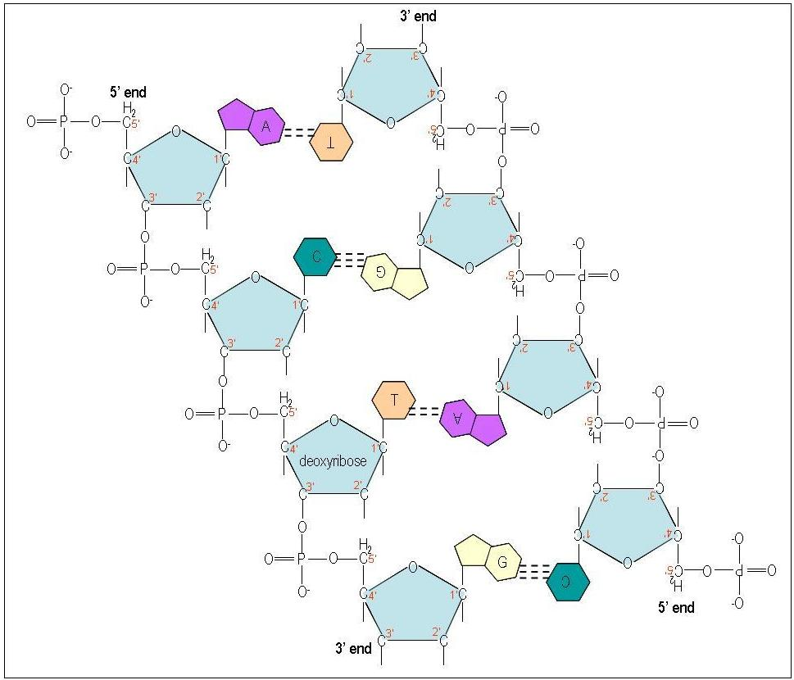
Antiparallel – two strands of DNA run in opposite directions 3’-5’ on one strand 5’-3’ on other strand

Slide 35
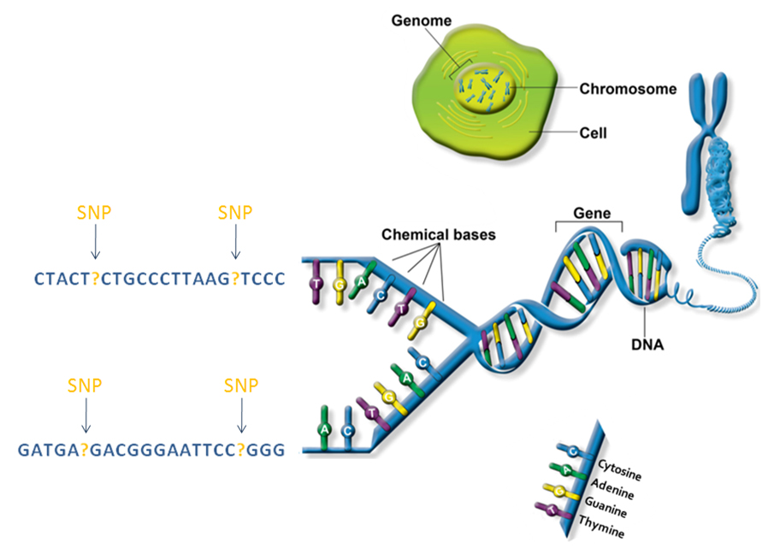

Slide 36
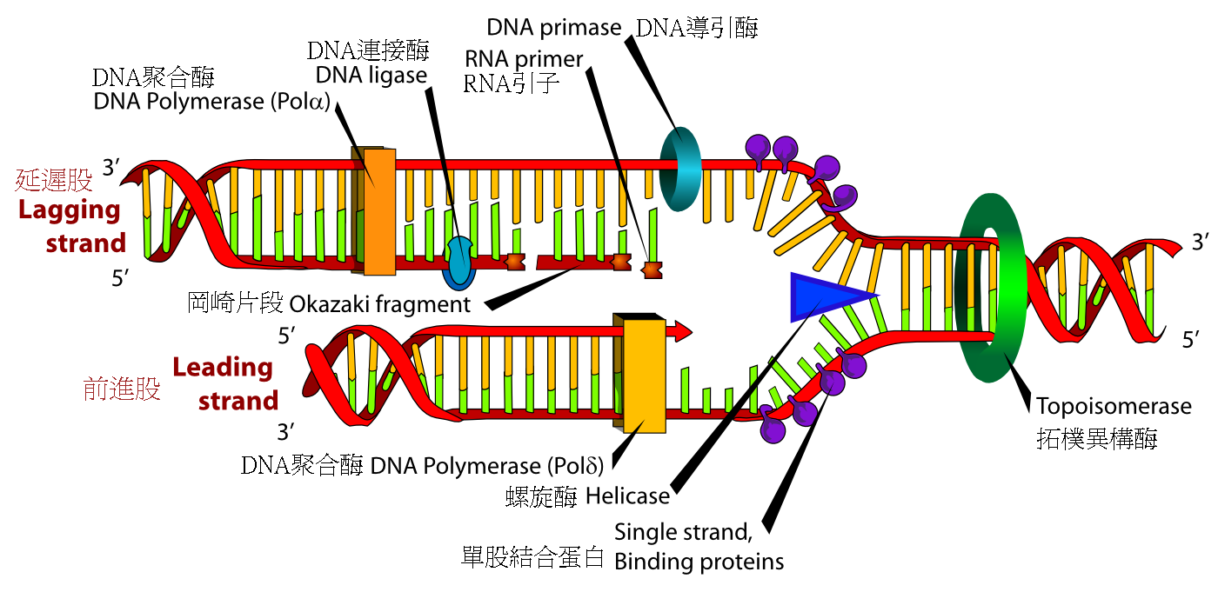
3/5
Turn in Pogil DNA structure if you have not.
Up next protein synthesis
1. Why is DNA semi conservative?
2. How does being semi conservative help against mutations (changes in DNA)?
Notes:
Half of it is the old one, half is the new one
2. semiconservative protects against mutations because if there is a mistake in one new strand the other new strand will not have that same mistake.

Slide 37
Compare the size of a DNA molecule to the size of the human body.
Describe some of the levels of magnification illustrated in this Web feature and how they relate to each other.
What kinds of scientific tools might you need to see the information as you see it here?
What is the role of DNA in the cell? The human body?

Slide 38
Journey into DNA
http://tpt.pbslearningmedia.org/resource/tdc02.sci.life.gen.journeydna/journey-into-dna/
Write down some notes

Slide 39
Cracking the code
http://video.pbs.org/video/1841308959/

Slide 40
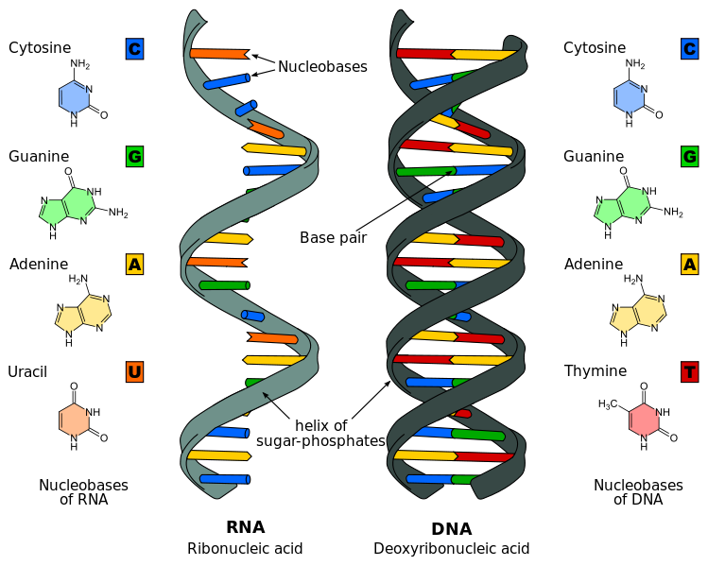
3/6
What are the differences between DNA and RNA?
What does DNA stand for?
Notes:
Single stranded
Quiz next thursday

Slide 41
RNA – ribonucleic acid
Differences between RNA and DNA
1. Single stranded not double stranded.
2. contains uracil not thymine
3rd difference – if DNA is deoxyribonucleic acid
Function of RNA – turns instructions from DNA to protein

Slide 42
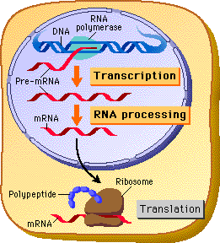
Transcription and Translation
In a eukaryotic cell the nuclear envelope separates transcription from translation
Extensive RNA processing occurs in the nucleus
Where does transcription and translation happen?

Slide 43
Replication – DNA copies itself
Protein synthesis
Transcription – DNA to mRNA
Translation – mRNA to Protein

Slide 44
Hand in
- Candy write up
POGIL DNA
Take notes in notebook on strawberry

Slide 45
3/10
Fill in the blanks with the correct vocabulary word (Replicate, transcribe, translate, DNA, RNA, amino acids, protein)
1.____ is _____ into RNA which is then _____ into ________.
2.Compare and contract transcription and translation. Where does each one occur?

Slide 46
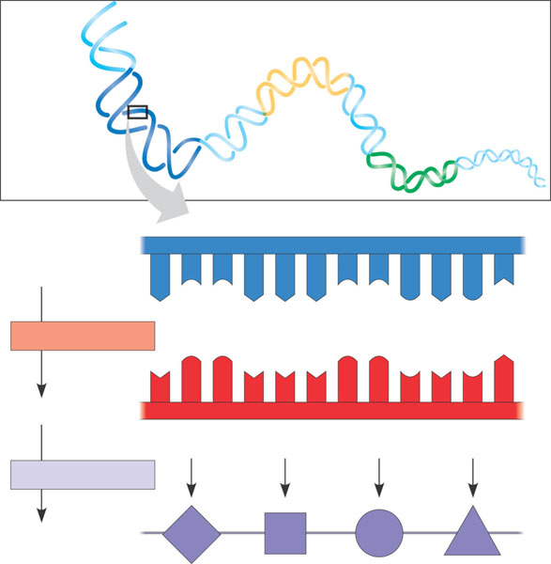
The Genetic Code
Genetic information is encoded as a sequence of nonoverlapping base triplets, or codons
DNA
molecule
Gene 2
Gene 1
Gene 3
DNA strand
(template)
3′
5′
A
C
C
A
A
A
C
C
G
A
G
T
TRANSCRIPTION
U
G
G
U
U
U
G
G
C
U
C
A
mRNA
5′
3′
Codon
TRANSLATION
Protein
Trp
Phe
Gly
Ser
Amino acid

Slide 47
The Genetic Code
Codons: 3 base code for the production of a specific amino acid, sequence of three of the four different nucleotides
Since there are 4 bases and 3 positions in each codon, there are 4 x 4 x 4 = 64 possible codons
64 codons but only 20 amino acids, therefore most have more than 1 codon
3 of the 64 codons are used as STOP signals; they are found at the end of every gene and mark the end of the protein
One codon is used as a START signal: it is at the start of every protein
Universal: in all living organisms

Slide 48
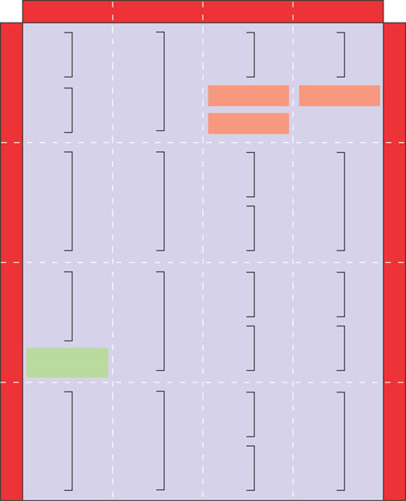
The Genetic Code
A codon in messenger RNA is either translated into an amino acid or serves as a translational start/stop signal
Second mRNA base
U
C
A
G
UUU
UCU
UAU
UGU
U
UUC
Phe
UCC
UAC
Tyr
UGC
Cys
C
U
UUA
UCA
Ser
UAA
Stop
UGA
Stop
A
UUG
Leu
UCG
UAG
Stop
UGG
Trp
G
CUU
CCU
CAU
His
CGU
U
C
CUC
CCC
CAC
CGC
Arg
C
CUA
Leu
CCA
Pro
CAA
CGA
A
CUG
CCG
CAG
Gln
CGG
G
First mRNA base (5′ end)
Third mRNA base (3′ end)
AUU
ACU
AAU
Asn
AGU
U
AUC
lle
ACC
AAC
AGC
Ser
C
A
AUA
ACA
Thr
AAA
AGA
A
AUG
Met or
start
ACG
AAG
Lys
AGG
Arg
G
GUU
GCU
GAU
GGU
U
GUC
GCC
GAC
Asp
GGC
C
G
GUA
Val
GCA
Ala
GAA
GGA
Gly
A
GUG
GCG
GAG
Glu
GGG
G

Slide 49
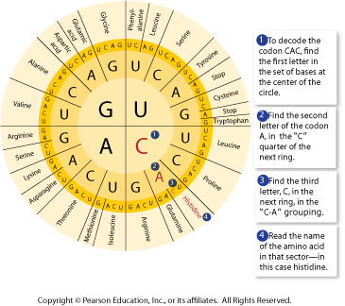
Start codon – first codon of mRNA, starts translation.
Stop codon- terminates translation

Slide 50
3/11
1. What is the Amino Acid that matches the following RNA sequence AUG-CGC-AUA?
2. What is the role of MRNA?
3. What is the difference between transfer RNA and messenger RNA
Quiz thursday
Notes:
Tranfer RNA brings the amino acids to the ribosome and m rna goes from the nucleus to the ribosome.

Slide 51
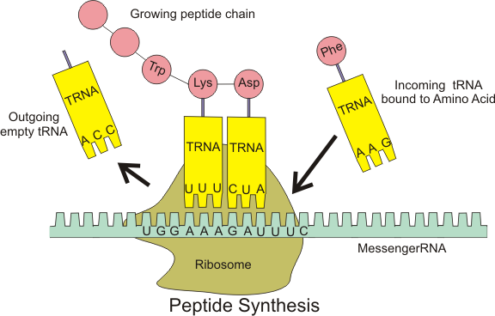
mRNA – messenger RNA – brings the transcribed sequence to the ribosome
T RNA Transfer RNA – brings amino acid to ribosome

Slide 52
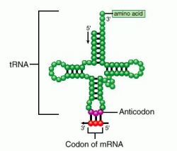
Anti codon – part of TRNA that is complementary to mRNA

Slide 53
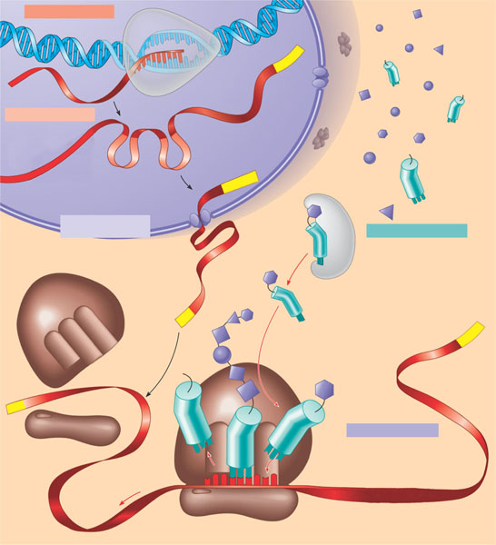
A summary of transcription and translation in a eukaryotic cell
TRANSCRIPTION
DNA
1
RNA is transcribed
from a DNA template.
3′
Poly-A
5′
RNA
transcript
RNA
polymerase
RNA PROCESSING
Exon
2
In eukaryotes, the
RNA transcript (pre-
mRNA) is spliced and
modified to produce
mRNA, which moves
from the nucleus to the
cytoplasm.
RNA transcript
(pre-mRNA)
Intron
Cap
Aminoacyl-tRNA
synthetase
NUCLEUS
FORMATION OF
INITIATION COMPLEX
Amino
acid
CYTOPLASM
tRNA
AMINO ACID ACTIVATION
3
After leaving the
nucleus, mRNA attaches
to the ribosome.
4
Each amino acid
attaches to its proper tRNA
with the help of a specific
enzyme and ATP.
mRNA
Growing
polypeptide
Poly-A
Activated
amino acid
Poly-A
Ribosomal
subunits
Cap
5′
TRANSLATION
C
5
C
A
U
A succession of tRNAs
add their amino acids to
the polypeptide chain
as the mRNA is moved
through the ribosome
one codon at a time.
(When completed, the
polypeptide is released
from the ribosome.)
E
A
A
C
A
Anticodon
U
A
A
G
U
G
G
U
U
U
A
Figure 17.26
Codon
Ribosome
Notes:
----- Meeting Notes (10/22/13 14:17) -----
misconception - dna becomes rna

Slide 54
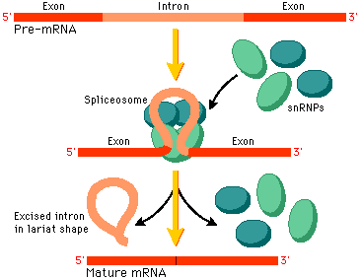
Intron – noncoding region (junk?)
Exon – part of RNA that gets coded into protein
Most of the DNA sequence is not coded into a protein so most mutations have no effect.
Mutations in the non coding region are less harmful, becaue they have no effect. This is why we we more variation in the nocoding regions of the DNA

Slide 55
Mutation – Change in a base pair of DNA
most mutations have no effect on an organism since most of the DNA sequence is non coding

Slide 56
Protein synthesis wkst
www.stepsofproteinsynthesis.org/protein-synthesis-worksheet.doc‎
http://www.youtube.com/watch?v=NJxobgkPEAo

Slide 57
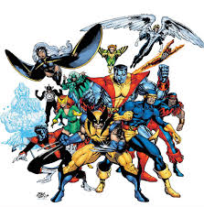
3/12
Agenda
- Warm up
Quiz review
DNA writing prombt
1. What is one new thing you learned in the DNA unit?
Why would most slight mutations have little effect on an organism?
Tomorrow Quiz and
Notebook check from 2/25

Slide 58
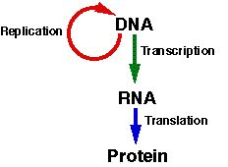
On the review guide – find 2 or 3 questions you can answer and circle them. Focus on those questions while watching the short video.
http://www.youtube.com/watch?v=NJxobgkPEAo
Describe the three main functions of DNA
Notes:
Walk around and make sure everybody has one circled
Store, copy and transmit

Slide 59
Parts of DNA?
Which parts are in the backbone?
Which represent the rungs or steps of the ladder?

Slide 60
TTC – ACC- GCA
What is the complementary pair?
What is the mRNA code?
Predict the amino acid sequence.
Notes:
Complementary pair – aag-tgg-cga
mRNA code Aag-ugg-cga
Aa lysine, tryptophan arginine

Slide 61
Contract DNA with RNA
Compare DNA to a book.
http://www.youtube.com/watch?v=0Elo-zX1k8M
Notes:
DNA contains T, RNA contains uracil
RNA is single stranded DNA is double strained
DNA stays in the nuclues, RNA goes to the ribosome.
You can replicate, transcribe or translate a book.

Slide 62
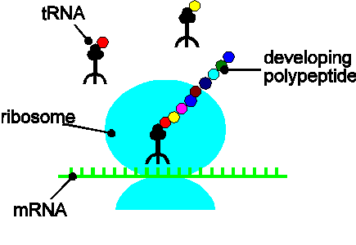
Compare tRNA with mRNA.
What does each one do

Slide 63
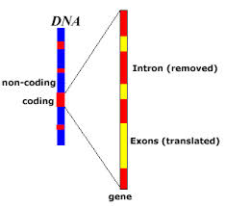
Are most mutations helpful, harmful or mutual
Why?

Slide 64
A summary of transcription and translation in a eukaryotic cell
1
TRANSCRIPTION
DNA
RNA is transcribed
from a DNA template.
3′
Poly-A
5′
RNA
transcript
RNA
polymerase
2
RNA PROCESSING
Exon
In eukaryotes, the
RNA transcript (pre-
mRNA) is spliced and
modified to produce
mRNA, which moves
from the nucleus to the
cytoplasm.
RNA transcript
(pre-mRNA)
Intron
Aminoacyl-tRNA
synthetase
NUCLEUS
Cap
FORMATION OF
INITIATION COMPLEX
Amino
acid
AMINO ACID ACTIVATION
CYTOPLASM
3
tRNA
After leaving the
nucleus, mRNA attaches
to the ribosome.
4
Each amino acid
attaches to its proper tRNA
with the help of a specific
enzyme and ATP.
mRNA
Growing
polypeptide
Poly-A
Activated
amino acid
Ribosomal
subunits
Poly-A
Cap
5′
C
5
TRANSLATION
C
A
U
A succession of tRNAs
add their amino acids to
the polypeptide chain
as the mRNA is moved
through the ribosome
one codon at a time.
(When completed, the
polypeptide is released
from the ribosome.)
E
A
A
A
C
Anticodon
U
A
A
G
U
G
G
U
U
U
A
Ribosome
Codon
Describe the role of DNA in determining the protein that make up your body. (4-5 sentances) Vocabulary
DNA, mRNA, tRNA, transcription, translation, replication, codon, protein, Amino Acid
Figure 17.26
Notes:
----- Meeting Notes (10/22/13 14:17) -----
misconception - dna becomes rna

Slide 65
3/14
DNA quiz review
What are the 3 functions of DNA
What are the parts of a nucleotide?
What are the 4 bases and which one pair up?
What are 3 major differences between DNA and RNA?
What the 3 types of RNA and what is the function of each?
3 types of mutations – What is their affect on cells?
Create a diagram of protein synthesis.

Slide 66
Writing prompt
Compare and contrast transcription and translation. Where do they take place? How is their chemical make up different? (5-6 sentences)
http://www.youtube.com/watch?v=NJxobgkPEAo

Slide 67
3/13
Are you ready for the quiz?
Why is it incorrect to say that DNA changes to mRNA?
After DNA becomes copied (replication) how many original and how many new strands are present?
Notebook check # of dates from 2/25
Notes:
DNA has information to be copied and passed on.

Slide 68
Create a summary of this show. Why is the DNA sequence important to understanding disease? What else did you learn about DNA? What issues are raised in this program?

Slide 69
What assignments are you missing?
What is an anti-codon?
What can you do this weekend to do better on the ACT.

Slide 71
Test Taking Hints
What can you do this weekend to be better prepared for ACT
Tips based on stuff I see from students taking science tests.
Procedure
Notice the number of questions and the time.
Glance to get the jist.
Read title carefully
Scan questions (notice number of questions)
Answer questions you understand first
General tips
What is the question asking?
If you see a word you don’t understand cover it and see if the question still makes sense.
Try not to panic – breath deeply
Notes:
Reflect on physics praxis -

