Slide 1
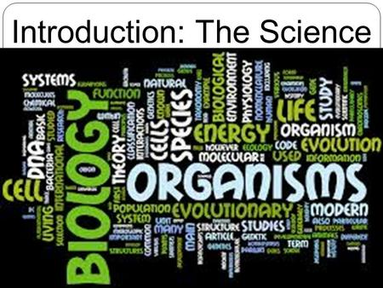
Characteristics of life
Biomolecules, levels of organization

Slide 2
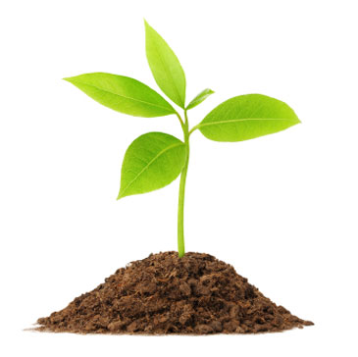
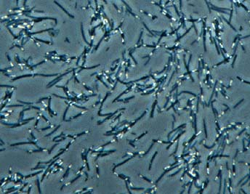
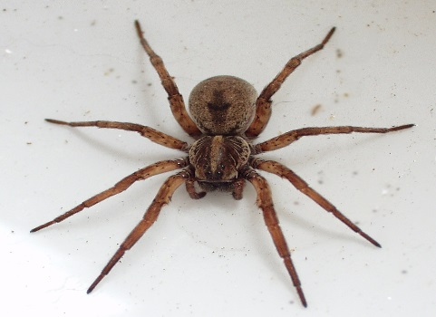
Seven Characteristics of All Life:
All life is made of cells.
All life grows.
All life reproduces.
All life has DNA.
All life evolves.
All life needs nutrients.
All life excretes waste.

Slide 3
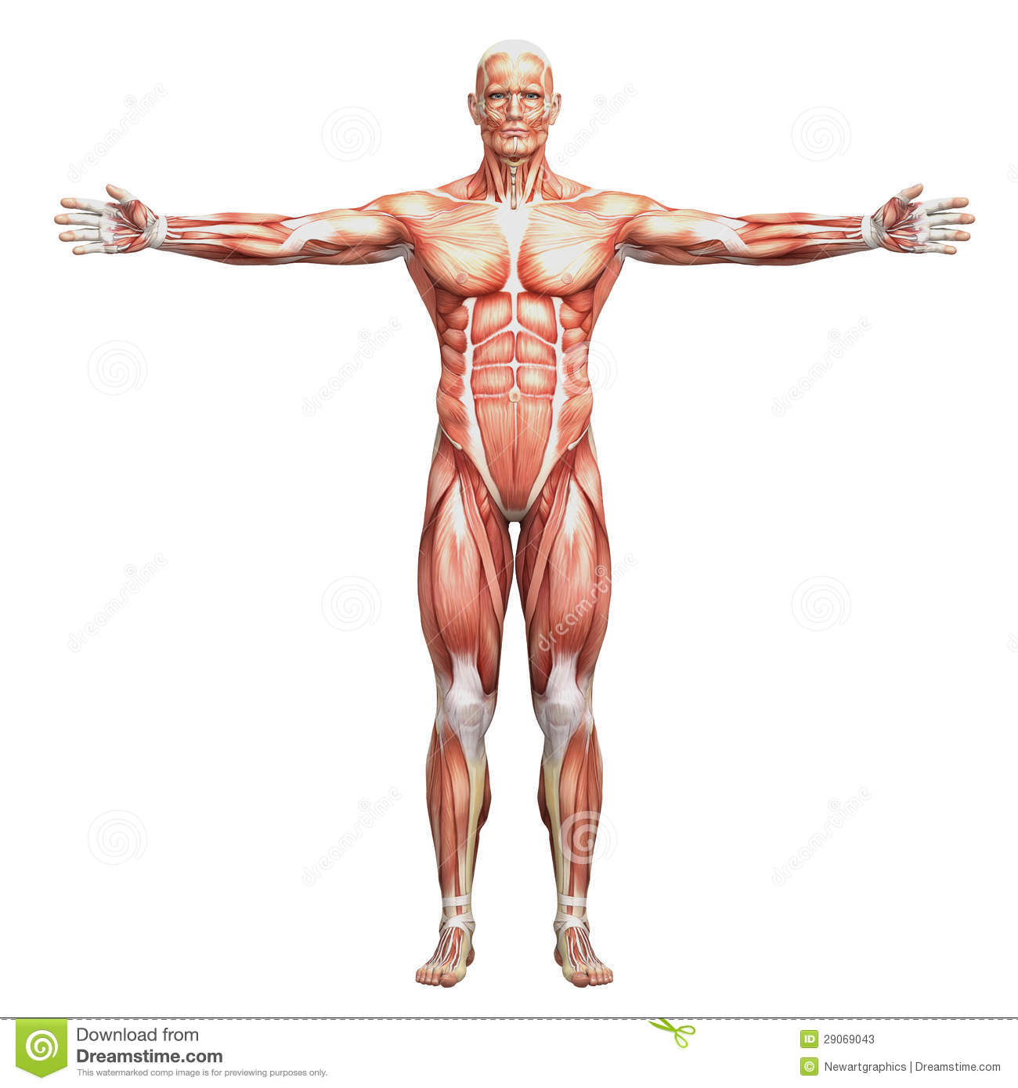
Levels of Organization Put these in order from smallest to largest:
Organelle
Atom
Tissue
Cell
Organ
Organ system
Molecule
Organism

Slide 4
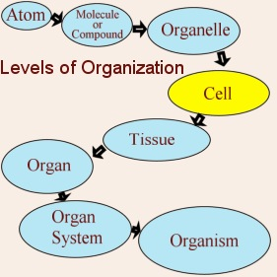

Slide 5
Energy is passed between living organisms
How?
Photosynthesis (formula: ____+____->____+____)
Respiration (formula: ____+____->____+____)
Why?
To get _________.
Who?
Who photosynthesizes? _________
Who respires? ___________
When?
When does a living thing photosynthesize or respire? When it ______ ______.

Slide 6
Biomolecules
Carbohydrates – quick, short-term energy
Proteins – growth and repair
Lipids – protection, long term energy
Nucleic acids – build DNA

Slide 7
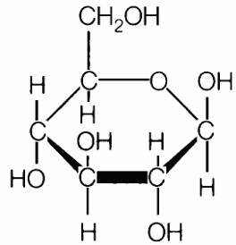
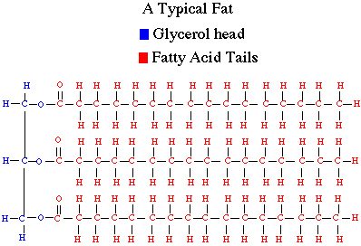
Make New Biomolecules
Plants and animals can make new molecules by rearranging the C, H, and O atoms in glucose.
For example, if you break apart many glucose molecules, you can make a lipid molecule.
------→
Glucose molecule
Lipid Molecule

Slide 8
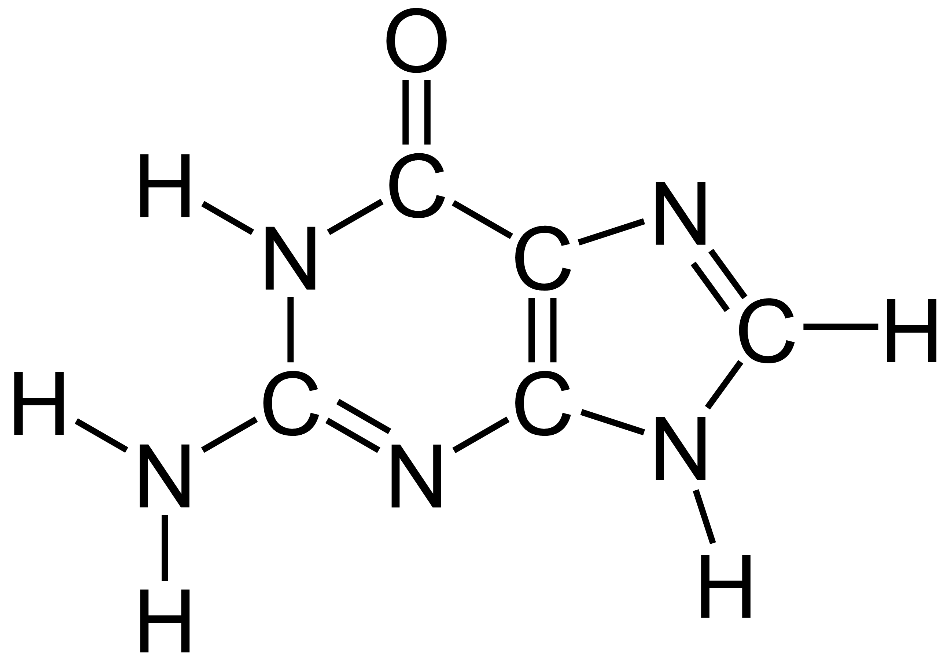
---------→
Protein molecule
Glucose molecule

Slide 9
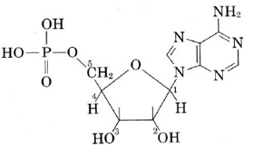
-------→
Glucose molecule
Nucleic Acid molecule

Slide 10
-------→
Nucleic Acid molecule
Protein molecule

Slide 11
Glycerol, triglyceride | lipids | Fatty acids

