Slide 1
Demographic Transition Model &
Age Structure Diagrams
{Human Population

Slide 2
Demographic Transition Model
The Demographic Transition Model is a model that proposes how populations should change over time in terms of their birth rates, death rates and total population size.
The demographic transition model explains the transformation of countries from having high birth and death rates to low birth and death rates.
In developed countries this transition began in the 18th century and continues today.
Less developed countries began the transition later and many are still in earlier stages of the model.

Slide 3
Demographic Transition Model

Slide 4
Stages
It originally consisted of 4 stages, and a fifth stage has been added.
In stage 1 both the birth rate and death rates are high and fluctuating
In stage 2 the Birth rates stay high throughout because improvements in society affected death rate first.
In stage 3 birth rates finally begin to fall and become almost on a par with death rates
In stage 4 both death rates and birth rates remain low and fluctuate, giving a steady population.
A final stage has been added to the model, based upon recent countries experiences.

Slide 5
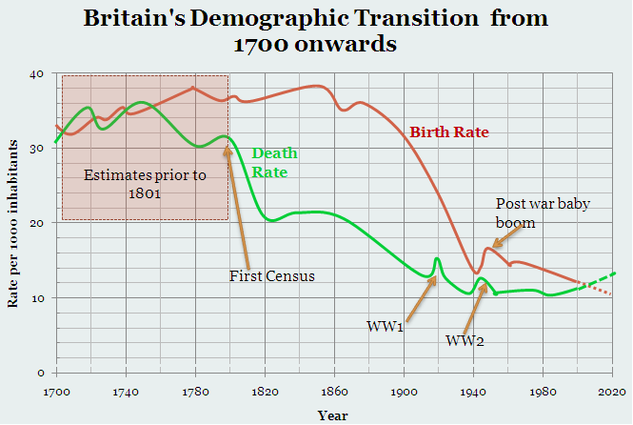

Slide 6
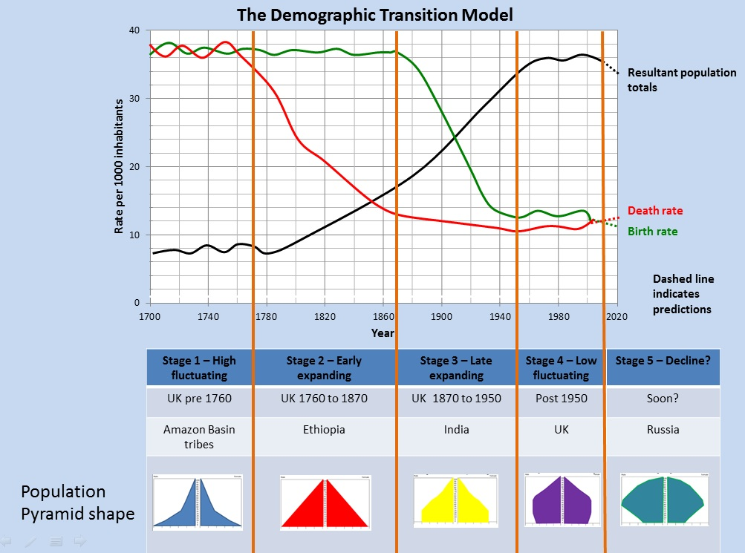

Slide 7
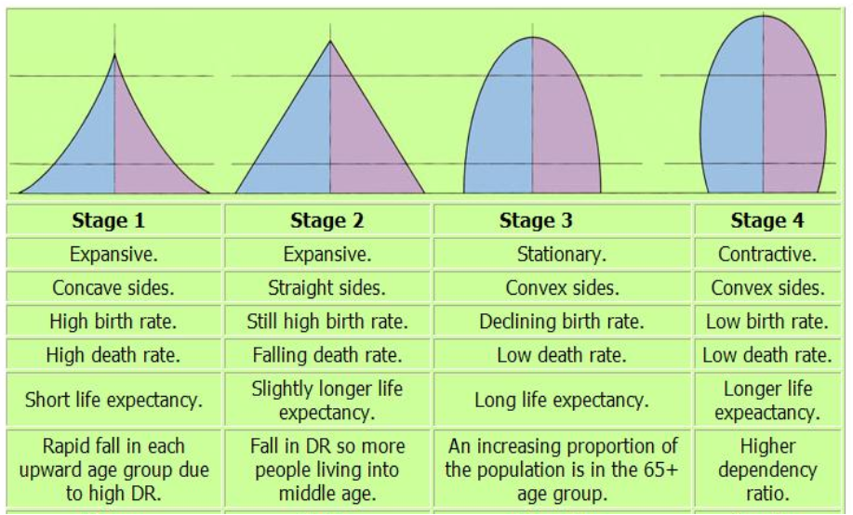

Slide 8
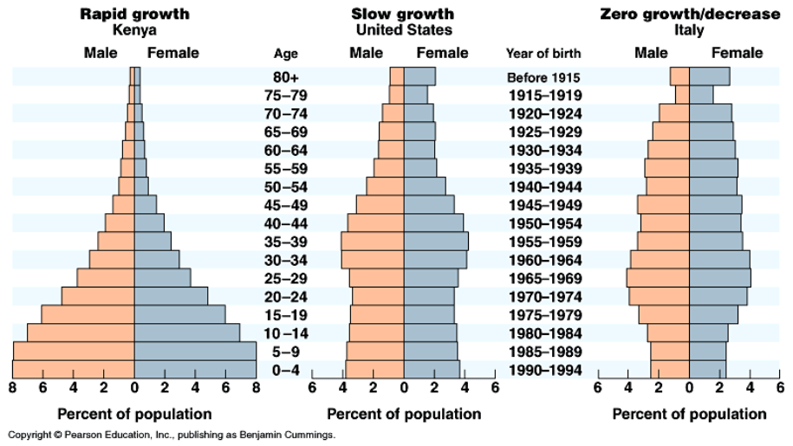

Slide 10
Simulation
Use the computer and go to this website. Answer the following questions.
http://www.learner.org/courses/envsci/interactives/demographics/demog.html
Change the country to Japan, make the birthrate as close to 1 per woman, and the death rate as close to 1.5 as possible. press play. Describe what happens to the graph and what it looks like.
Change the country to America, make the birthrate as close to 1.8 per woman, and the death rate as close to 2.0 as possible. press play. Describe what happens to the graph and what it looks like.
Pick a country and your birthrate and death rate. Write them down. Describe what happens to the graph and what it looks like.

Slide 11
Age Structure Diagram Posters
{Human Population

Slide 12
Age Structure Diagram
Create an age structure diagram for your provided country and the United States of America, in the year 1990, 2017 and 2035 (this is a total of 6 age structure diagrams).
Then compare the two different countries by answering the following questions in complete sentences and complete thoughts.
Arrange your 6 different age structure diagrams in an organized poster with your responses to the questions below. Be prepared to present your findings and defend your answers to the class.

Slide 13
Finding your data
http://www.census.gov/population/international/data/idb/informationGateway.php

Slide 14
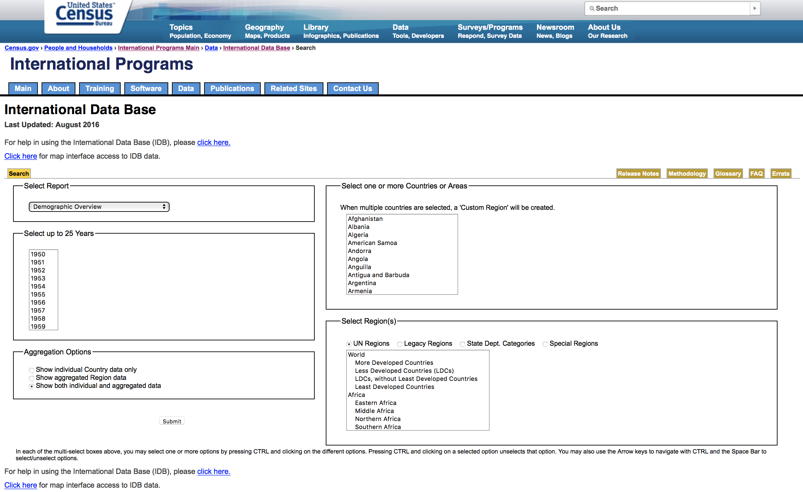

Slide 15
Select “Population by Five Year Age Group”
Select 1990 and 2017 by pressing and holding control, click 1990 and the scroll down and click 2017

Slide 16
Select “Show both individuals and aggregated data”
Select your chosen Country

Slide 17
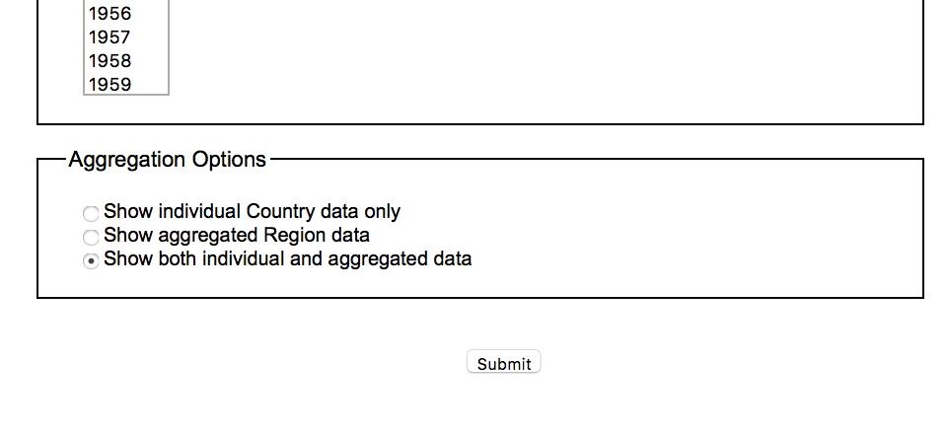
Do nothing here
Click “Submit”

Slide 18
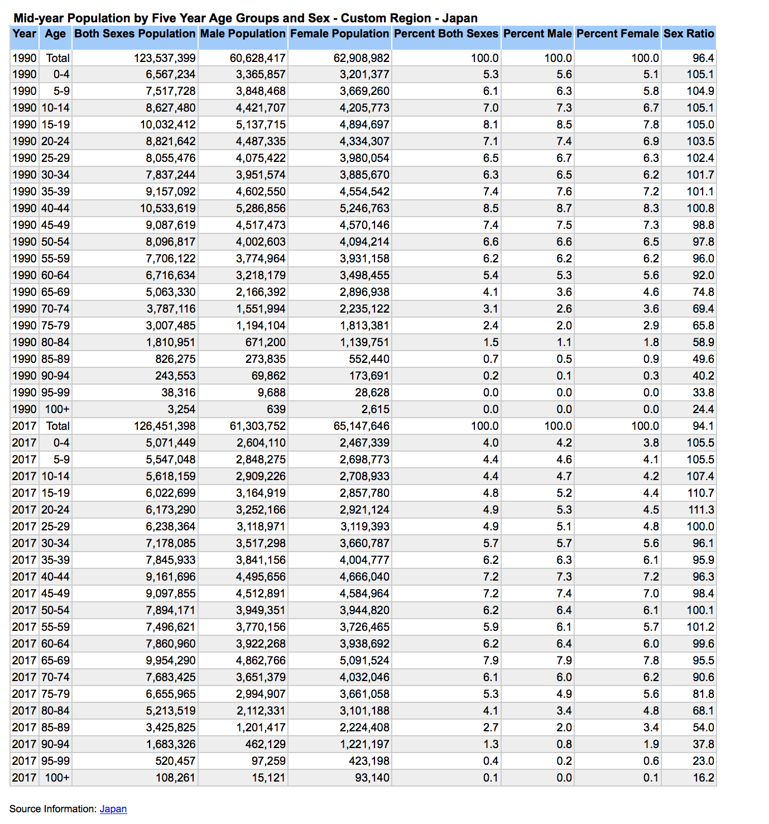
Pay Attention to the Year

Slide 19
Pay Attention to the Age

Slide 20
Pay Attention to the Male Population

Slide 21
Pay Attention to the Female Population

Slide 22
Save to Google Drive
Use 2 fingers to click on the touchpad
Select Print
The print page will open
Select Save
Select google drive on the left
Save somewhere to your drive.

Slide 23
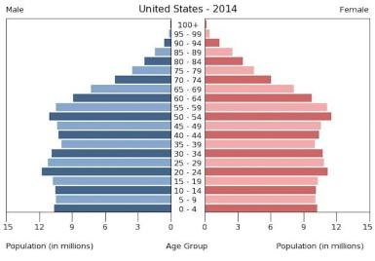
Male is ALWAYS on the left, make sure you color it blue

Slide 24
Female is ALWAYS on the right, make sure you color it red

Slide 25
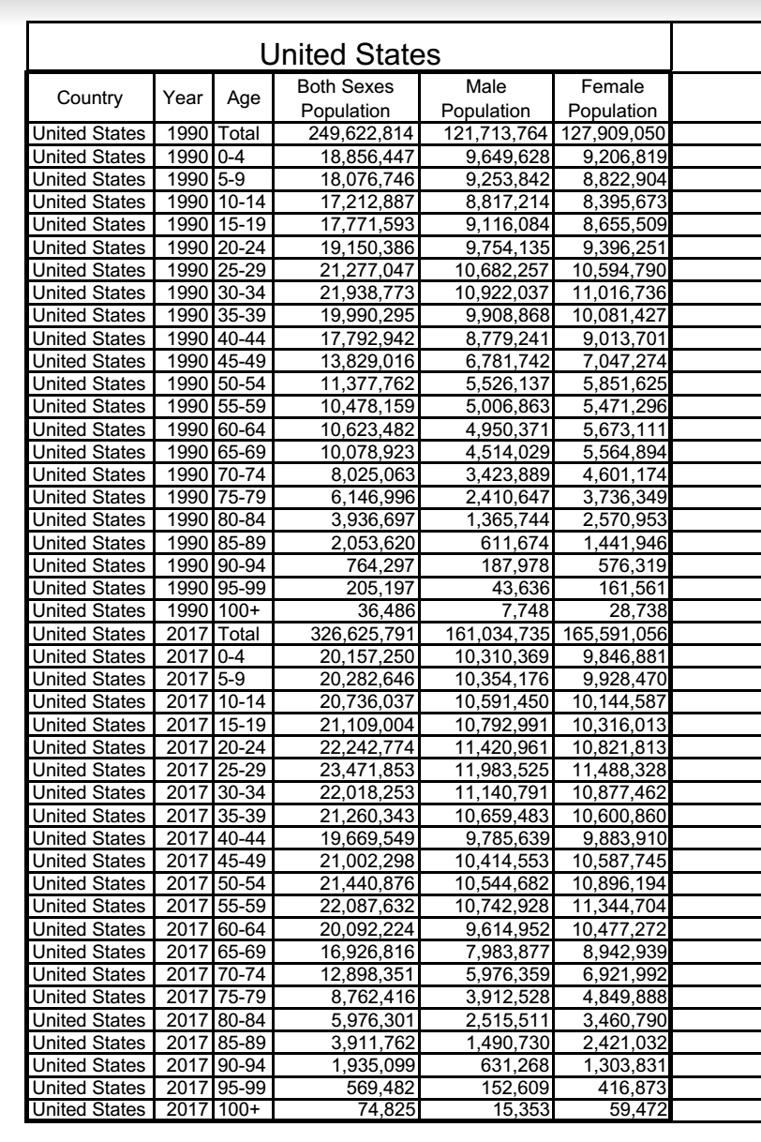
Let's Try Together
Grab a graph
Grab the United States Data

